Slide 1

Deep Dive:
Unlocking the Power of Board Leadership and Transformational Gifts
Dianne Chipps Bailey
National Philanthropic Strategy Executive
February 7, 2024

Slide 2
Disclaimer
Neither Bank of America Private Bank nor any of their affiliates or advisors provide legal, tax or accounting advice. You should consult your legal and/or tax advisors before making any financial decisions.
Institutional Investments & Philanthropic Solutions (“II&PS or Philanthropic Solutions”) is part of Bank of America Private Bank, a division of Bank of America, N.A., Member FDIC, and a wholly owned subsidiary of Bank of America Corporation (“BofA Corp.”). Trust and fiduciary services and other banking products are provided by wholly owned banking affiliates of BofA Corp., including Bank of America, N.A. Brokerage services may be performed by wholly owned brokerage affiliates of BofA Corp., including Merrill Lynch, Pierce, Fenner & Smith Incorporated (“MLPF&S”).
Certain Bank of America Private Bank associates are registered representatives with MLPF&S and may assist you with investment products and services provided through MLPF&S and other nonbank investment affiliates. MLPF&S is a registered broker-dealer, registered investment adviser, Member SIPC and a wholly owned subsidiary of BofA Corp.
Investment products:
© 2021 Bank of America Corporation. All rights reserved. | MAP3917816 | 11/2021
Are Not FDIC Insured | Are Not Bank Guaranteed | May Lose Value
Notes:
2

Slide 3

First things first – why are we here?
Shared passion for the power of community colleges to create affordable and high-quality pathways to economic opportunity

Slide 4

Role of the governing board
Strategic planning | President partnership | Financial oversight | Resource development | Risk management
Mission, vision and strategy | Hiring, assessing, supporting, and, when necessary, changing | Budget, audits, forecasts | Fundraising, advocacy, ambassadorship, marketing, social media and more | Catastrophic litigation, governmental investigation, negative headlines, reputational risk
Where are your obstacles
and opportunities?

Slide 5
Board development and engagement strategy
  Identify
  Cultivate
  Recruit
  Onboard
  Engage
  Educate
  Evaluate
  Rotate
Thank and thank again!

Slide 6
Why board diversity matters
Improved organizational performance
  Organizations that have gender diversity are 15% more likely to outperform homogenous organizations.
  Ethnically-diverse organizations are 33% more likely to outperform those that are not.
Enhanced risk management
Amplified mission advancement
  If nonprofits don’t understand these communities and hear directly from proximate voices, they are likely to misunderstand and may even inadvertently do harm.
Source: McKinsey 2018 Delivery Through Diversity Study

Slide 7

Two major types of barriers to board diversity
Structure
Culture

Slide 8


Major barrier: Structure
 | Obstacle | Opportunity
Candidate pipeline | Insularity | Openness
Access | Inflexibility | Flexibility
Board terms | Perpetual | Term limits
Fundraising | Give and get | Personally meaningful gift

Slide 9
Major barrier: Culture
 | Obstacle | Opportunity
Change management | Discomfort | Space for grace
Representation | Tokenism | Critical mass
Dynamics | Micro-aggressions and biases | Implicit bias training and personal/group growth
Role clarity | Lack of definition | Focus and purpose
Gratitude | Expectation | Appreciation

Slide 10
Board fiduciary duties
Good faith
Due care
Loyalty
          Conflicts of interest
          Obedience
          Confidentiality

Slide 11
Rights of directors
          Access to information
          Notice of meetings
          Quorum
          Unanimous written consent requirements
          Record of dissent
          Special meetings
          Resignation

Slide 12
Protect the board from personal liability
          Business judgment rule
          Limitation of liability
          Statutory immunity
          Indemnification
          D&O insurance

Slide 13
Hot topics in board governance
          Size of board
          Role of executive committee
          Director independence
          Term limits
          Board-President relationship
          Executive session

Slide 14
Key policies and procedures
  Articles of incorporation
  Bylaws
  Conflict of interest policy
  Investment policy statement
  Spending policy
  Whistleblower policy
  Document retention/destruction policy
  Form 990 review policy
  Gift acceptance policy
  Employee manual

Slide 15
Board meeting architecture
          Align with five key responsibilities of the Board
          Packets and portals
          White space for generative, creative and strategic visioning
          Internal and external resources
          Right number of meetings?
          Trust and conflict
          Mission first always!

Slide 16
Board meeting planning worksheet
Five core responsibilities of nonprofit boards Strategic planning: Mission, vision, strategy CEO partnership: Hiring, assessing, supporting, changing Financial oversight: Budget, audits, forecasts Resource development: Fund raising, advocacy, ambassadorship, marketing, social media Risk management: Catastrophic litigation, governmental investigation, negative headlines, reputational risk
January | March | May | August | September | November
Consent agenda: Approval of minutes, financials and other routine/noncontroversial items
“Mission Moment”
Business agenda: | Business agenda: | Business agenda: IRS Form 990 Audit | Business agenda: | Business agenda: | Business agenda: Slate Budget
Board Strategic Engagement: | Board Strategic Engagement: | Board Strategic Engagement: | Board Strategic Engagement: | Board Strategic Engagement: | Board Strategic Engagement:
Other: | Other: | Other: | Other: | Other: | Other:
Executive Session

Slide 17
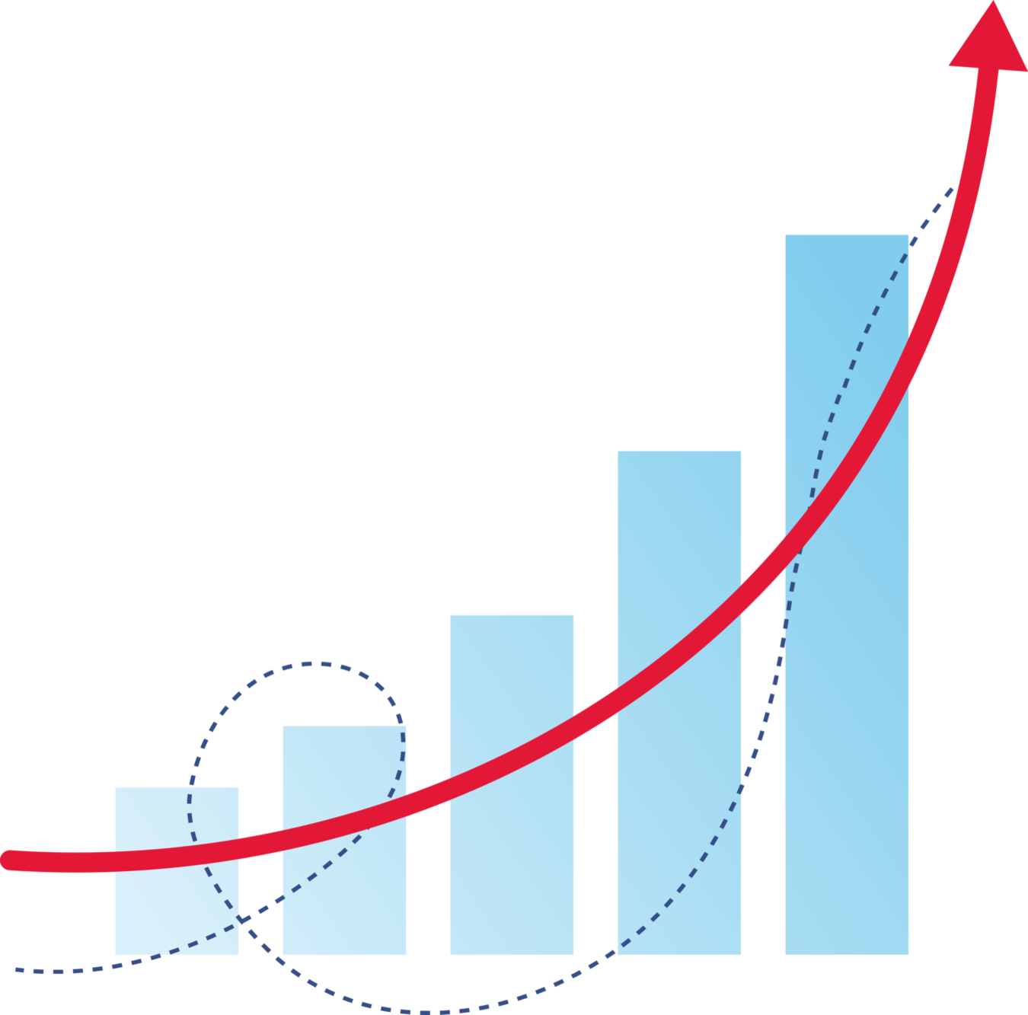
URGENT!!! Historic wealth transfer underway
$84T expected to pass to heirs and nonprofits in next 20-25 years¹
Women and rising generation (primarily Gen X and Millennials) to benefit
$12T already earmarked for charity
Nonprofits to act NOW!!
  Donor affinity initiatives
  Gift planning (vs. planned giving)
¹ U.S. High-Net-Worth and Ultra-High-Net-Worth Markets 2021, Cerulli Associates, January 2022
Notes:
For the income qualification ($200,000 a year or more), we are hitting the top 5.6% of all households. Our median income value is squarely in the $200,000 to $500,000 bracket, which would put them at about the highest 5%. Our mean is around $525,000 (using midpoint imputation), which would give us a mean of about the top 1%.
Data to make similar wealth comparisons (to the U.S. population) are not available. We can use IRS data to show how our sample compares to the American population on income. However, we don't have an outside source that shows the distribution of wealth (net assets) in the U.S. population, so there's nothing to compare our wealth amounts to — to let us make a statement about what percentage of the population we're capturing.
Additional note re: point #2: In 2018 (the latest year available), 5.6% of all returns were from households reporting adjusted gross income of $200,000 or more. Looking only among itemizers, this value is 25%. Of itemized giving ($19 billion), filers with $200,000 or more in adjusted gross income gave $135 billion (69%).

Slide 18
Beyond checkbook giving: Unlock the potential of illiquid assets
Distribution of American household wealth
Distribution of American charitable giving methods among high net worth donors
Cash: 7%
Cash or check donation: 95%
Financial Assets: 31%
Financial Assets: 7%
Non-Financial Assets:
7%
Non-Financial Assets: 62%
Source: Federal Reserve. Changes in U.S. Family Finances from 2007 to 2010 (2012) (latest data available); Financial Accounts of the United States (2014) (latest data available).
Source: Bank of America. Study of High Net Worth Philanthropy (2021).

Slide 19
Gift planning for impact today
Not all planned gifts are deferred!
Start with non-cash gifts including appreciated securities, real estate and more
Giving USA Foundation, 2022; GUSA Leaving A Legacy Report, 2019.
What happens in the same year
when gifts shift from cash to assets?
5-year average growth in total fundraising
NONPROFITS receiving
ONLY
CASH gifts
NONPROFITS receiving
ANY
NONCASH gifts
NONPROFITS receiving SECURITIES NONCASH gifts
when share
from
SECURITITES
GROW
when share
from
REAL ESTATE
GROWS
when share
from
CASH
GROWS
66%
GROWTH
by +10%
total
contributions
fall by
by +10%
total
contributions
grow by
by +10%
total
contributions
grow by
11%
GROWTH
50%
GROWTH
-13%
+18%
+26%
Source: Cash in Not King in Fundraising: Results from 1 Million Nonprofit Tax Returns, Dr. Russell James, 2018.
Notes:
For the income qualification ($200,000 a year or more), we are hitting the top 5.6% of all households. Our median income value is squarely in the $200,000 to $500,000 bracket, which would put them at about the highest 5%. Our mean is around $525,000 (using midpoint imputation), which would give us a mean of about the top 1%.
Data to make similar wealth comparisons (to the U.S. population) are not available. We can use IRS data to show how our sample compares to the American population on income. However, we don't have an outside source that shows the distribution of wealth (net assets) in the U.S. population, so there's nothing to compare our wealth amounts to — to let us make a statement about what percentage of the population we're capturing.
Additional note re: point #2: In 2018 (the latest year available), 5.6% of all returns were from households reporting adjusted gross income of $200,000 or more. Looking only among itemizers, this value is 25%. Of itemized giving ($19 billion), filers with $200,000 or more in adjusted gross income gave $135 billion (69%).

Slide 20
Gift planning for impact today (cont.)
  Donor-advised funds are key
    DAF assets totaling $243B in 2021, up from $112B in 2017
    1.29MM DAF accounts
    Grants from DAFs to qualified charities totaled an estimated $46B in 2021 – 26% increase compared to 2020 (new high-water mark!) and 400% increase over 10 years
    DAF payout rate was 27% in 2021
    DAF donors are often philanthropic first responders, but anonymity can complicate stewardship
  Also Qualified Charitable Distributions (QCDs) from retirement accounts
    SECURE 2.0 Act makes QCDs even more desirable
Source: Giving USA Foundation, 2022; GUSA Leaving A Legacy Report, 2019. National Philanthropic Trust, Donor-Advised Fund Report 2022
Notes:
For the income qualification ($200,000 a year or more), we are hitting the top 5.6% of all households. Our median income value is squarely in the $200,000 to $500,000 bracket, which would put them at about the highest 5%. Our mean is around $525,000 (using midpoint imputation), which would give us a mean of about the top 1%.
Data to make similar wealth comparisons (to the U.S. population) are not available. We can use IRS data to show how our sample compares to the American population on income. However, we don't have an outside source that shows the distribution of wealth (net assets) in the U.S. population, so there's nothing to compare our wealth amounts to — to let us make a statement about what percentage of the population we're capturing.
Additional note re: point #2: In 2018 (the latest year available), 5.6% of all returns were from households reporting adjusted gross income of $200,000 or more. Looking only among itemizers, this value is 25%. Of itemized giving ($19 billion), filers with $200,000 or more in adjusted gross income gave $135 billion (69%).

Slide 21

Gift planning for impact tomorrow
Bequests still most popular planned gifts¹
  Bequests are already 9% of annual giving ($46B in 2021!)
  Remember: $12T already is earmarked for charity in next 20-25 years
  44 is average age donors make a will
  53 is average age donors add a charitable beneficiary to their will
At all ages, consider charitable beneficiaries of retirement plans and
insurance policies
With interest rates rising, Charitable Gift Annuities and Charitable
Remainder Trusts again are relevant
¹Giving USA Foundation, 2022; GUSA Leaving A Legacy Report, 2019.
Notes:
For the income qualification ($200,000 a year or more), we are hitting the top 5.6% of all households. Our median income value is squarely in the $200,000 to $500,000 bracket, which would put them at about the highest 5%. Our mean is around $525,000 (using midpoint imputation), which would give us a mean of about the top 1%.
Data to make similar wealth comparisons (to the U.S. population) are not available. We can use IRS data to show how our sample compares to the American population on income. However, we don't have an outside source that shows the distribution of wealth (net assets) in the U.S. population, so there's nothing to compare our wealth amounts to — to let us make a statement about what percentage of the population we're capturing.
Additional note re: point #2: In 2018 (the latest year available), 5.6% of all returns were from households reporting adjusted gross income of $200,000 or more. Looking only among itemizers, this value is 25%. Of itemized giving ($19 billion), filers with $200,000 or more in adjusted gross income gave $135 billion (69%).

Slide 22
Philanthropy begins with the Board
Fundraising is a key responsibility of each Board member
Begin with your personally meaningful gift
Perfect your elevator speech – back it up with data and stories
Scan and engage your sphere of influence
Listen intently…
Discern your optimal role in the fundraising cycle:
      Identification and research
      Cultivation
      Solicitation
      Follow-up
      Stewardship
Engage, evaluate and encourage your expert professional development team
Repeat!

Slide 23
Attributes of great boards
          Humility
        The source of curiosity and growth
          Courage
        Are we empowered to act outside
        of meetings?
        Are we willing to make the
        difficult decisions?
          Self-awareness
        What kind of board are we?
        What are our strengths and gaps?
        Where are our greatest aspirations?
          Vision and ambition
        Organizational, not personal
          Passion
        Commitment to the mission.
        Passion is essential; sentiment
        is deadly.
          Independence and integrity
        Loyalty to the community trust
          Appreciated and thanked!

Slide 24


Wisdom in the Room
Let’s continue the conversation!
Dianne Chipps Bailey linkedin.com/in/diannechippsbailey/ twitter.com/Dianne_C_Bailey

