Slide 1

Mining for those data diamonds!
Notes:
My title is program manager, strategic research and analytics…I wear many hats including prospect research, database managements, strategic planning and Foundation analytics
Today I’d like to show you, with minimal software, how you can use data to inform decisions and improve ROI for your fundraising events, board engagement and your organization’s overall performance
So much of advancement involves story telling but it’s also vital to have data to back up anecdotes

Slide 2
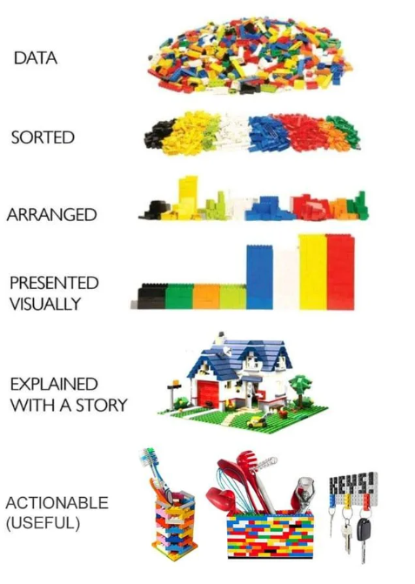
Notes:
Collecting data is the first step but it’s useless until you ORGANIZE it, ANALYZE it, EXPLAIN it, and ACT on it
https://web.stanford.edu/group/sdgc/cgi-bin/ycisl/?p=4927

Slide 3

Data Uses shown here
Board composition analysis
Post event analysis
Foundation Scholarship Dashboard
Audiences
Board members
Chancellor/President
Executive Director
Donors/Prospects
Notes:
In this session I’m going to review just 3 ways I use Foundation data to improve our performance:
Conducting a board composition analysis- Who is on our board, where are they from, what do they do, who are we missing
Conducting a post event analysis- What was our ROI, did we invite the right people?
Creating a scholarship dashboard- What is the Foundation’s impact year over year? Are we meeting our mission?
Who needs to see this information-the decision makers!

Slide 4
Utilize Software & College resources
All FREE!
All done with Excel reports exported from donor database or event software
Microsoft PowerBi
  https://www.youtube.com/watch?v=TmhQCQr_DCA
Office of Analytics & Institutional Reporting
  Try Records, Admissions, Technology Services
Notes:
You can create dynamic, free info graphics with software you probably already have and a little practice
Everything you’re going to see today was made from excel spreadsheets and Microsoft office products
Ask your colleagues, don’t reinvent the wheel! These departments may already have the queries in place to tell you more about your scholarship recipients

Slide 5
Board Composition Analysis
Excel grid breaking out members’ demographics: residency, business sector, committee, age, ethnicity, alumni, etc.
Uses:
Find gaps in representation- business sector, geography etc.
Repeat exercise with board member prospects
Notes:
It’s important to build a strong board because these will be your ambassadors in the community
Create a excel grid that lists all your members along with some basic demographic information and color code it- a visual representation makes it easier to spot trends, holes
When you have a list of board prospects, add their lines to the bottom and see if they help round out the board

Slide 6
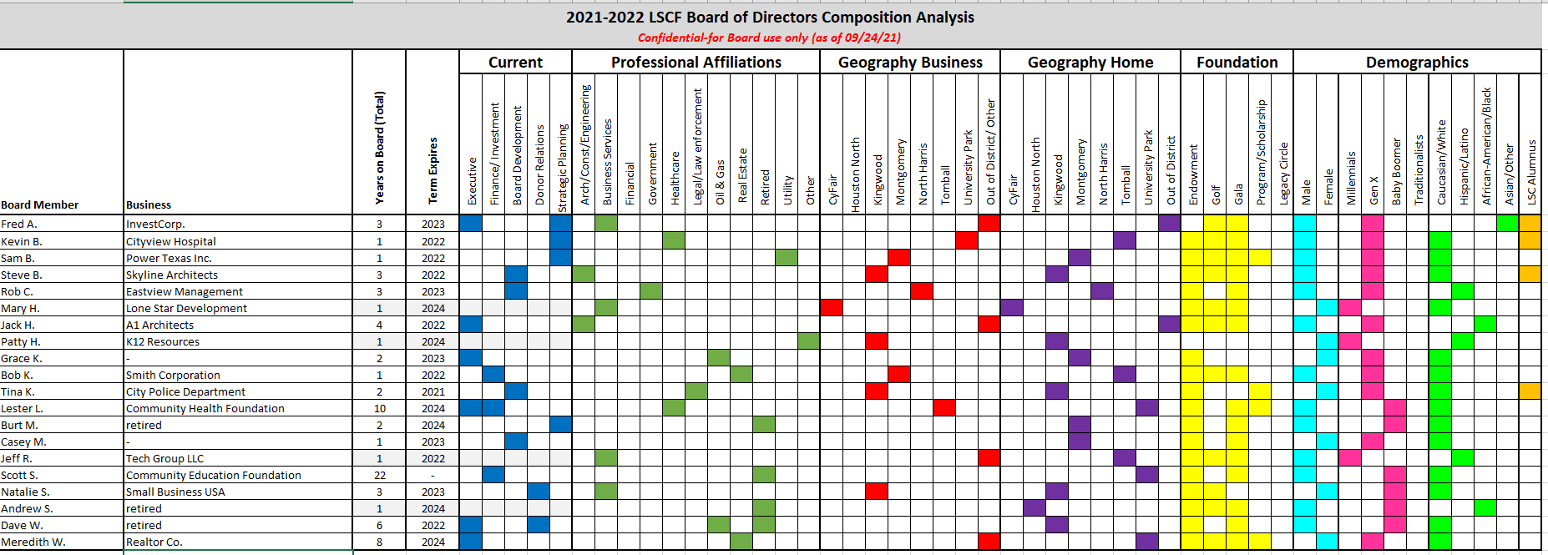
Notes:
Demographics included: Professional affiliation, work location, home location, type of giving, gender, age group, ethnicity, alumni status

Slide 7
Analyze then take action
Does your board reflect your student body?
Does it align with Foundation/College priorities?
Highlights gaps that may direct future board prospect decisions
*Remember your audience, respect donor privacy
Notes:
This isn’t about checking boxes…all board members should be qualified but it’s good to not put all your eggs into one basket-it’s important to have different viewpoints, experiences etc.
If all your board is from Oil & Gas and therefore a lot of your major gifts are from Oil & Gas, what do you do when there’s a downturn?
Are community leaders and major employers involved at your college? Do they support the Foundation? Are you setting yourself up for long-term success with engaged, generous board members or just transactional?
LSCF’s board used to be mainly engineering and architecture firms because of their vendor commitments to the college but not anymore

Slide 8
Post event analysis
Tells a visual story and allows for dynamic, more in-depth analysis
THINK: What’s your purpose and who’s your audience?
Ideally think of what you want to measure prior to event: Sponsor level/location/business sector/guest purchases etc.
Notes:
Again, showing the data in a visual way is often more impactful
After any event, it’s important to do a debrief and this analysis should be included
Oftentimes events are the go-to fundraiser, but are they worth it? Are we maximizing the ROI? ROI not only in a financial sense, but in staff commitment, donor/prospect engagement
You can’t change what you don’t know about…what are we capable of measuring, what do we need to start tracking?...consider this when looking at event software

Slide 9
Post event analysis
Example measures: year over year revenue & expenses, revenue by sponsor type/business sector/auction package type/guest type, sales by table
Utilizes Excel and PowerBi
Notes:
For the following examples, we have Greater Giving for our software but you could also track this information in excel…I often build out from excel because I can set it up with the exact fields I want
I learned PowerBi from youtube and some tutorials that our IT dept. offered…see if your colleagues can help!
Think of Microsoft PowerBi as a powerpoint presentation with dynamic graphs and charts

Slide 10
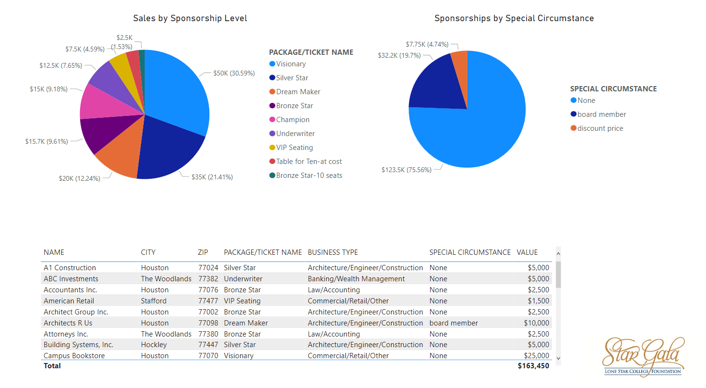
Notes:
PowerBi lets you export data into DYNAMIC charts & graphs…better visual to spot patterns, problem spots
Can be used in presentations, shared & FREE to download…check with your college, they may already have a membership
The pie charts are pulling the data from the spreadsheet at the bottom
Are you putting too many eggs in one basket with your sponsorship levels? Is income only from low hanging fruit?

Slide 11
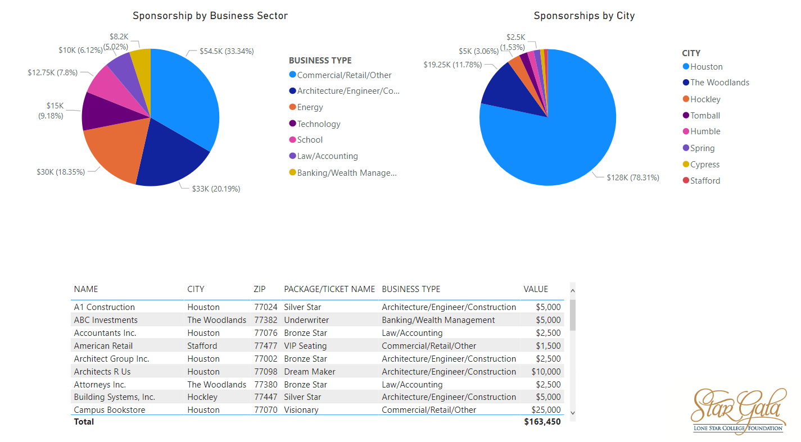
Notes:
Are you diverse in your business support? What about geographically? Do only vendors support? Transactional vs. philanthropic
Start to measure year over year…are they becoming loyal donors? Are they increasing their support?

Slide 12
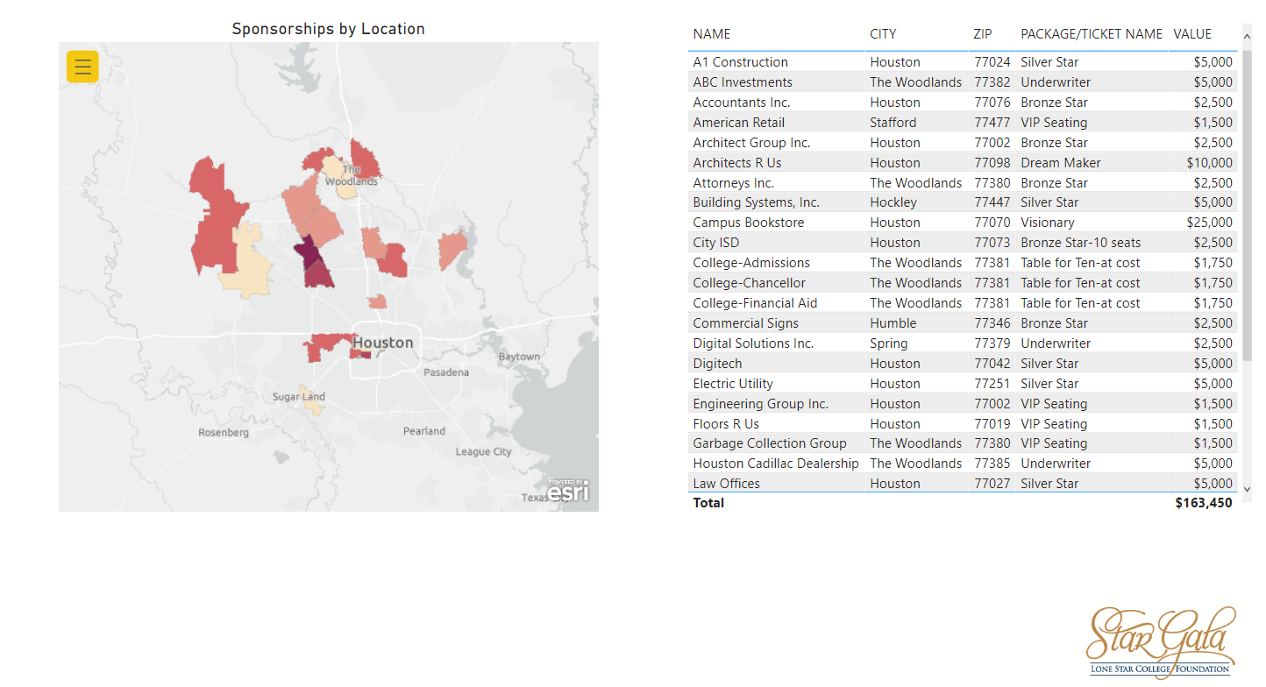
Notes:
Use a map to pinpoint hotspots, show gaps in coverage
This is a heat map by zip code, the darker the color the higher the revenue
It pulls data from the list into a map module, similar to a pie chart or graph
LSC covers 1,400 sq miles but we don’t want all our guests/donors coming from one side of town- it’s not good for optics or long-term growth

Slide 13
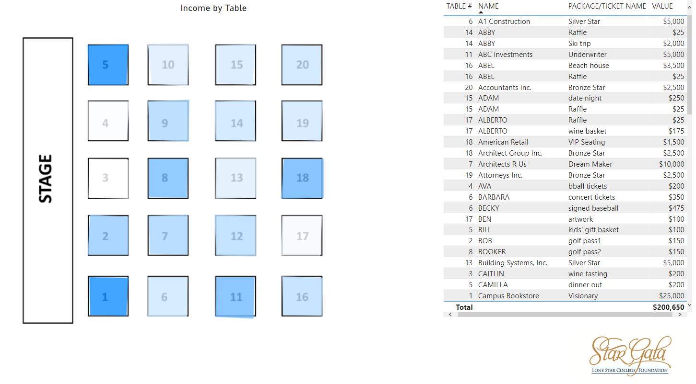
Notes:
This is a heat map by table seating, the darker the color the higher the total income from all the guests at the table including the sponsorship level
This is a module where I made the table layout, “traced” over it and mapped it to the table # & value columns
Are your biggest donors in the best seats? The highest sponsorship levels should receive priority seating. Are the live auction bidders in front?
Do staff tables generate money/bring in donors? The heat map includes guests’ auction purchases…If staff seats are sold at cost and they don’t buy anything, you basically didn’t fundraise from that table. I’m not saying that no employees should be invited, but it’s important to consider if this is a fundraiser or friend-raiser, is this the only opportunity for employees to give?
Show college leadership the value of inviting prospects & loyal donors, not use seats as staff perks
Are there any hidden gems who need more attention? Did someone bring a guest you want to invite specifically next year, start engaging? Did a donor indicate they have a higher giving capacity?
If you do this for the previous year’s event, you can use it to inform your seat assignments for this year’s event.

Slide 14
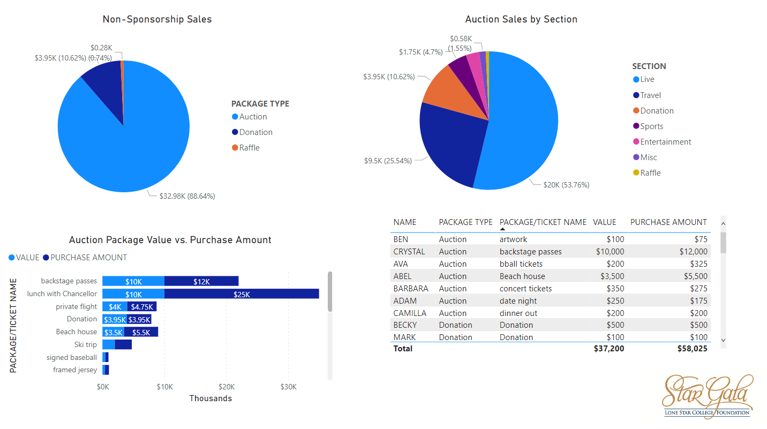
Notes:
Do certain auction sections do really well & need to expand/remove dud sections?
Are guests bargain shopping or paying top dollar?
Are we placing bids high enough?

Slide 15
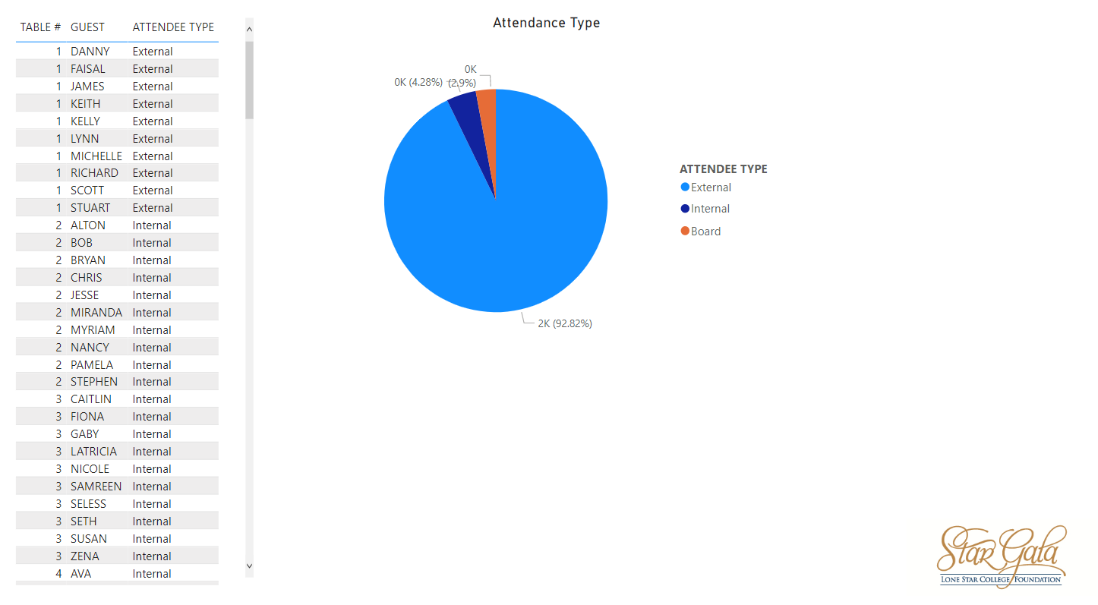
Notes:
Who attends our event? Is it too staff heavy?

Slide 16
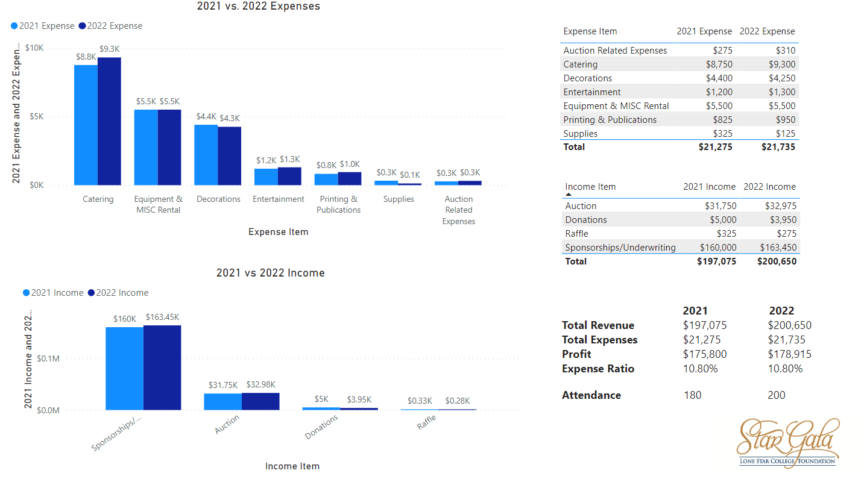
Notes:
How did we compare to last year?
You can make this more detailed the more info you provide.

Slide 17
Post event analysis
Potential Findings
  Need more diversity in sponsorship & revenue streams
  Need to refocus auction packages
  Need to change seating strategy
  Find hidden gems/new prospects
  *Remember to protect donor privacy based on audience
Notes:
Data backed decision-making! If you didn’t track it, did it even happen?
REMEMBER-you can do a nearly similar presentation with powerpoint and excel pie charts
It’s all about making your events more strategic so you can optimize your goals-whether it’s raising money or finding prospects
Are there other KPI’s you want to start tracking year over year?
Depending on the audience, you might not show giving specifics…If auction participants are anonymous, I wouldn’t display that but if sponsors & their sponsorship levels are promoted on your website, I would include those

Slide 18
Foundation Scholarship Dashboard
THINK: What’s my purpose? What are my long-term goals? What’s on my wish list?
Work with College Depts. (Admissions, Financial Aid, Institutional Reporting)
  It’s more tedious but could be done in Excel
  Info at your fingertips vs. submitting a request & waiting on analysts to compile a report
Notes:
This last example is a multi month project that I needed help from the college’s analytics dept. who could pull data from students’ financial aid records
This dashboard idea started with a problem: How can I find KPI’s more directly related to scholarships…I see stats on enrollment trends, persistence & completion rates etc. but not about scholarship students
Perhaps this can’t be a living dashboard but a saved query that you can request your financial aid or analytics dept. to pull periodically and send you an excel report.

Slide 19
Foundation Scholarship Dashboard
Uses:
  Internal audit- are we fulfilling our mission?
  Sell yourself- scholarships are a great ROI!
  Donor stewardship- show donors their impact!
  Support anecdotes with numbers!
  Find areas for growth- lack of aid for specific group, location?
Notes:
I’m sure the Chancellor and board wants to know if we’re doing what we’re supposed to do
Scholarship recipients perform better than their non-scholarship peers-here’s the proof
Use these factoids to brag about your impact, share in stewardship reports, press releases etc.
Where is there room for improvement, your weak areas may able indicate weak areas elsewhere- is it part of a larger, college-wide effort?
Share your wish list with other depts….what’s something you’d like to see or show to donors/internal VIPs but don’t currently have data on

Slide 20
Foundation Scholarship Dashboard
Metrics include:
  Scholarships by Academic year
  Scholarships by College (multi-campus system)
  Student demographics- ethnicity, age group, gender etc.
  Area of Study
  Special groups- first generation, healthcare programs etc.
Notes:
This data already exists but it needs to be accessible, dynamic, and interpreted
What kinds of #s do your leadership & donors care about? $ raised, # of students awarded?

Slide 21
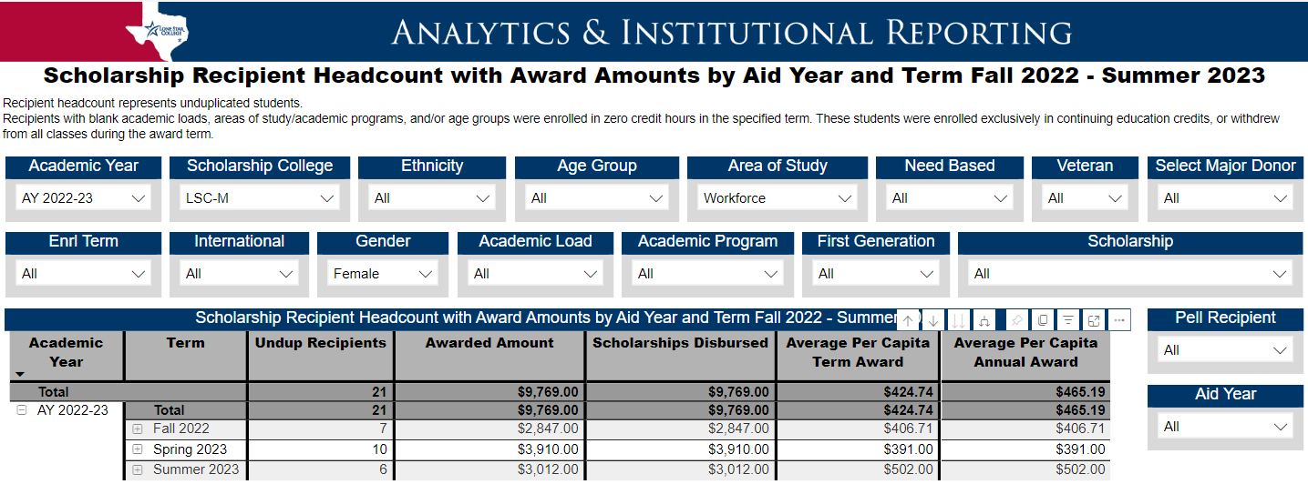
Sample query: How many female, workforce students at
LSC-Montgomery were awarded scholarships in AY22-23?
Notes:
Also useful to add a drop-down filter with the scholarship names…for some of the larger scholarships you can use this data in donor stewardship reports about their SPECIFIC recipients!
A donor comes to you and asks if there’s a need to fund X degree program or X special population….is there a legitimate need or is it over funded? Is there a big enough pool of potential recipients?

Slide 22
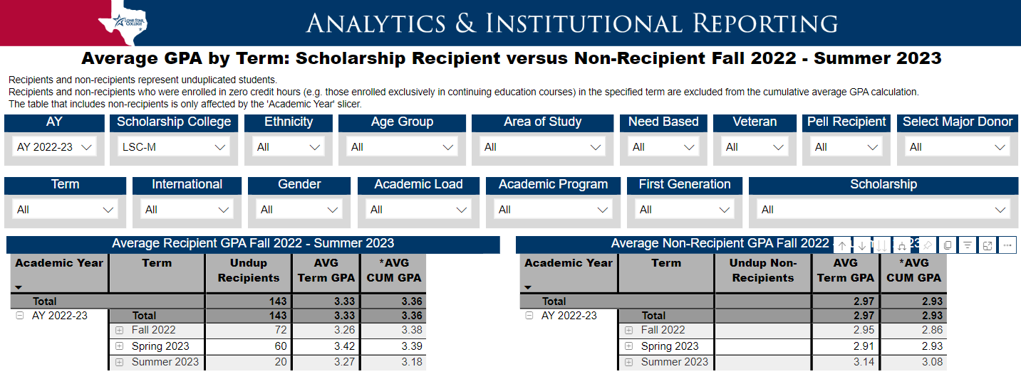
Sample query: How do LSC-Montgomery scholarship recipients compare against non-scholarship peers in AY22-23?
Notes:
We consistently see a higher avg. GPA for scholarship recipients vs. their non-scholarship peers…no matter the major, the demographic, or the year
Include in a donor stewardship report that their gift has a direct, tangible impact on the performance of their scholarship recipients
It’s helpful to include the analytics dept. who are the statistical experts because it’s easy to get into the weeds and semantics matter, so make sure you’re clear when using academic lingo…helpful that the developer included the disclaimers

Slide 23
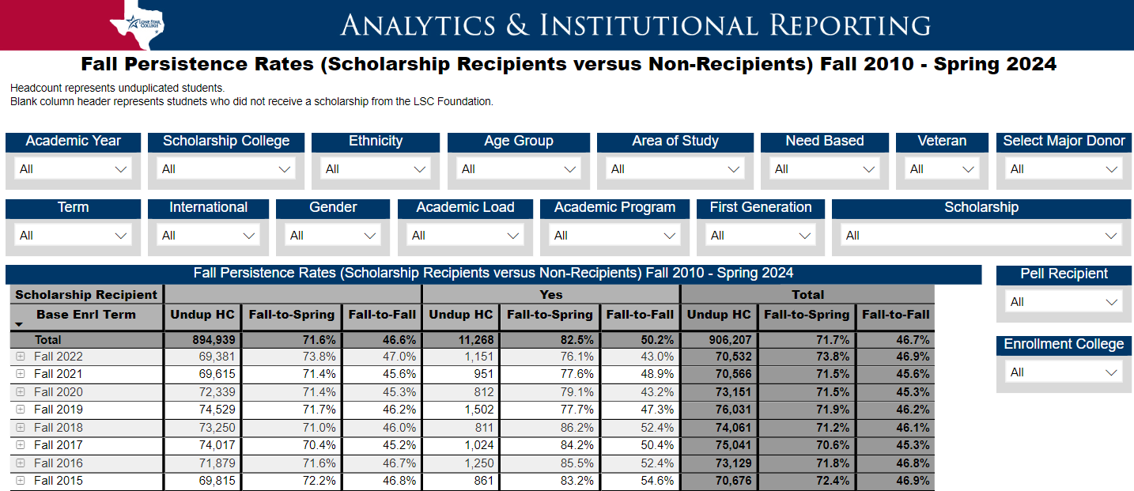
Sample query: Over time, how does persistence compare between scholarship recipients & their non-scholarship peers?
Notes:
This will vary over time-especially because of the pandemic- LSC is averaging around 15% (low 70s vs high 80s)
Use as a persuasion metric to increase resources/staffing allocated to the foundation ☺

Slide 24
Foundation Scholarship Dashboard
Key Takeaways discovered
  Avg. GPA is higher for scholarship recipients vs. non-scholarship peers
  Persistence is higher for scholarship recipients
  Scholarship distribution mirrors the student population
  Track year over year performance
Notes:
Data reinforces your strategic plan, your annual reports, even performance reviews

Slide 25
Notes:
In conclusion, remember data is your friend, you just need to ORGANIZE it, ANALYZE it, EXPLAIN it, and ACT on it

Slide 26

Questions, Comments?
  caitlin.s.miller@lonestar.edu
  832.813.6543

