Slide 1
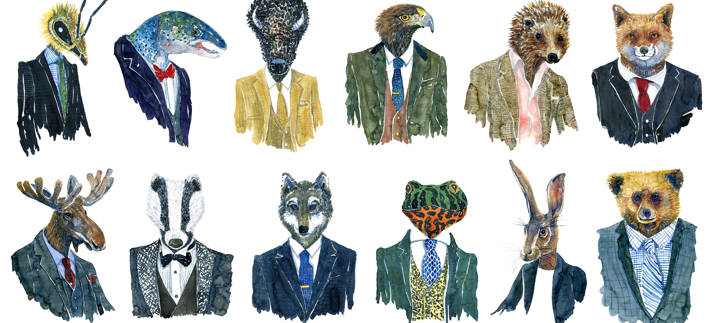
Taming a WILD Foundation Board
And Channeling Their Energy For Good!
Holly Lang, Principal
Victor Brooks, Consultant
TACCF Annual Conference
February 8, 2024

Slide 2
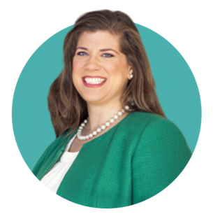
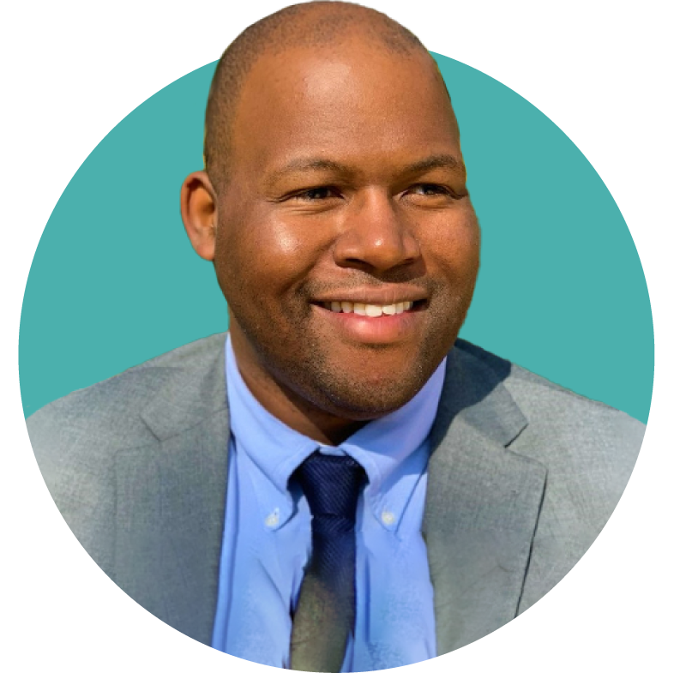

Your Dini Spheris Team
Holly Lang
PRINCIPAL
Victor Brooks
CONSULTANT

Slide 3
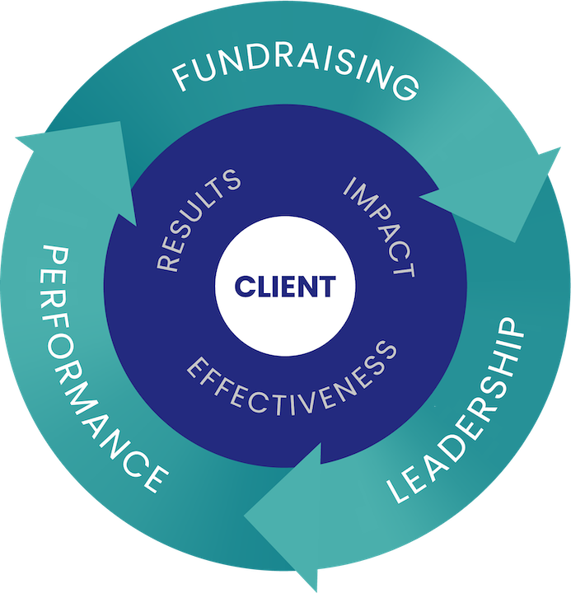

The Dini Spheris Advantage
54 years of results in fundraising, leadership and performance
Willingness to think outside the box of traditional fundraising
Proven track record of fundraising success with campaign goals of up to $1 billion
Belief in a values-based, donor-centered approach to philanthropy and fundraising
Customized and client-centered solutions for where you are today – and where you desire to go

Slide 4

Today’s Discussion
Organizational & Board Life Cycles
Developing a High Functioning Board
  Board Leadership
  Recruitment / Ongoing Engagement
  Fundraising
Q&A: Crucial Conversations & Sticky Situations

Slide 5
What Kind of Zoo Are You Running?
Organizational and Board Life Cycles

Slide 6
Nonprofit Life Cycles
Start-Up and Growth
+ Energy and excitement
- Lack of focus
Adolescent
+ Lots of “workers” and new, interested supporters
- Rapid change and lack of systems
Maturity
+ Security and adequate resources
+ Ability to innovate
- Natural tension between “old” and “new”
Stagnation
+ Chance to think “outside the box” again
- Declining excitement and disengagement

Slide 7
Board Life Cycle
Organizing
Volunteer leaders acting as additional staff
Very involved in day-to-day activities
Governing
Working with staff, focused on operational issues
Mature/Fundraising
Work centers on strategic and long-term planning and visioning
Oversight, governance, and management are a major focus
Fundraising is a major role and responsibility

Slide 8
Recognize Where You Are
Identify and stay committed to the ideal position for your organization
Acknowledge and celebrate the many milestones between what may be “today’s reality” and the ideal position
Organizational growth and board growth happen incrementally
Systematic, purposeful and focused steps advance growth!

Slide 9
Extreme Zoo Makeover!
Developing a High-Functioning Board

Slide 10
The Most Effective Board Members…
Present – Attend meetings and important functions
Informed – Not afraid to ask questions
Active – Serve on a committee or task force
Donors – Set a personal example; give and get
Advocates – Unified voices in the community
Which of these are the most difficult?

Slide 11
The Most Effective Boards…
Share the values and vision of the organization
Appreciate and commit to the role of philanthropy
Are educated on programming
Self-evaluate annually
Are active (not passive) participants – involved!
Know and respect the boundaries with staff
Work effectively as a team
Which of these are the most difficult?
Notes:
Question: Which of these do you find are the hardest??

Slide 12
Issues that Undermine Effectiveness
Lack of orientation and training
Lack of systems and structure (Terms. committees, collaboration, etc.)
Lack of a strategic plan
Lack of commitment to the vision (e.g., “lone rangers”)
Perhaps most importantly… absence of succession plans
What else has gotten you off track?

Slide 13
Strong Board Leadership
Notes:
MAM

Slide 14
Your Closest Ally
Developing a strong relationship with your Board Chair can be extremely helpful to helping guide your board in the right direction.
Meeting Convener
Peer Influencer
Initial “Asker”
Law Enforcement
Early Adopter

Slide 15
Recruiting New Board Members
Notes:
MAM

Slide 16

Right People: Who?
Right people > Right number
Seek influence and/or affluence
Diverse representation:
age, gender, professional skills, geographic representation, etc.
Ability to listen, analyze and be a team player

Slide 17
Right People: How?
Determine personalized strategy to recruit
Set clear expectations… in writing!
  Roles and requirements
  Anticipated time commitment
  Giving expectations
Share policies and procedures
  Length of service term, meeting schedule, nominating process, etc.
  BOARD ORIENTATION STARTS LONG BEFORE RECRUITMENT!

Slide 18

Right People: How?
An active Committee on Directorship is key
  Conducts analysis of board requirements
  Identifies prospective board members
  Recommends and nominates future board leadership
Notes:
Great place for senior board members / people rolling off
Analysis of leadership needs
Board skill-sets and leadership matrix
Board recruitment packet
Board Orientation

Slide 19
Maintaining Engaging Board Service
Notes:
MAM

Slide 20
Why is Your Board Here??
Financial Oversight
Fundraising
Sure…but what else??

Slide 21
Engaging Your Board Members
Advocacy
  Education
  Involvement
Strategic Planning
  Committee Work
  Coordination with College
  Annual Review
Student Programming
  Mission Moments
Stewardship
  Declaring Victory
Community Engagement
  Networking
  Business Development
  Event Planning
Alumni Relations
  Building Culture

Slide 22
A Board’s Role In Fundraising
Notes:
MAM

Slide 23
The Board and Giving
WHO? 100% of the board!
WHAT? A personally meaningful annual gift
WHEN? Early in the fiscal year. First, not last!
HOW? Begin with board chair; personal asks from staff and board chair; set the right tone
WHY? Corporations, foundations and savvy major donors use this as a measure of the leadership’s investment and confidence in the organization

Slide 24
Board Fundraising: Discovery / Cultivation
Asking Guiding board members toward who and how to recruit new donors, connections, and volunteers will help them be successful.
Strategic prospect lists that take advantage of their backgrounds
Manageable numbers of prospects 1 – 2 at a time
Understanding the goal of their conversation
Scripting, talking points, and materials (if needed)
Regular check-ins outside of board meetings
Follow-up and reporting on next steps with THEIR prospects

Slide 25
Board Fundraising: Solicitation
Some board members will never be askers and that’s okay!
(Be sure to tell them that)
Lead by example – first make a personal, generous stretch gift
Be part of a solicitation team, without being the person to ask
Set up the case for support and talk about why
Follow-up after a solicitation to help close a gift

Slide 26
Board Fundraising: Stewardship
Stewarding a donor is just as important as stewarding a board member, no matter how small their role.
Continued acknowledgement in board meetings
Celebration of every milestone: meeting / solicitation / closing gift
Allowing them to be a “subject matter expert”
Involvement in stewardship events and celebrations
Small victories will build the confidence of your board!

Slide 27
Boards Gone Wild!
Crucial Conversations & Sticky Situations

Slide 28
Obstacles for Boards & Staff
My board members don’t come to meetings / engage
My board members won’t come to events
My board is too involved in day-to-day operations
How do I politely excuse people from the board?
Everybody just wants to host parties…
Others??

Slide 29
Contact Information
Holly Lang
Principal
Victor Brooks
Consultant
hlang@dinispheris.com
713.942.1213 (w)
832.715.7248 (c)
vbrooks@dinispheris.com
713.942.1228 (w)
361.813.5649 (c)
2727 Allen Parkway Suite 1650
Houston, Texas 77019

