Slide 1

Wow Your Donors with Stewardship
They Won’t Soon Forget
Holly Lang, Principal
Victor Brooks, Consultant
TACCF Annual Conference
February 8, 2024

Slide 2
Today’s Discussion
Who Are We? Who Are You?
Stewardship Basics – What it Is, What it’s Not
What Today’s Donors Want
  Generational Trends
  Institutional Funders
Making Your Foundation’s Plan
Get Creative!

Slide 3
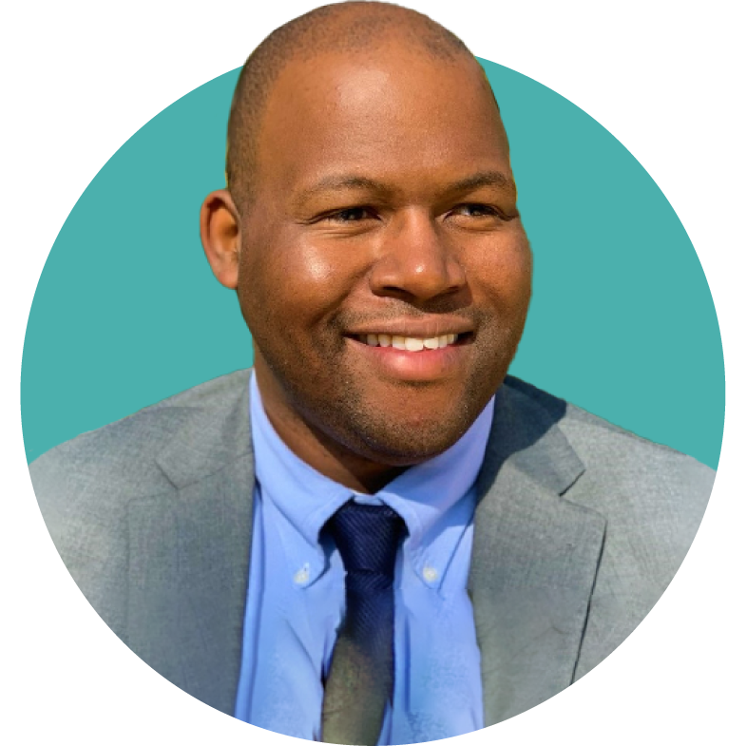
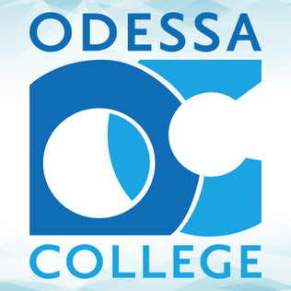






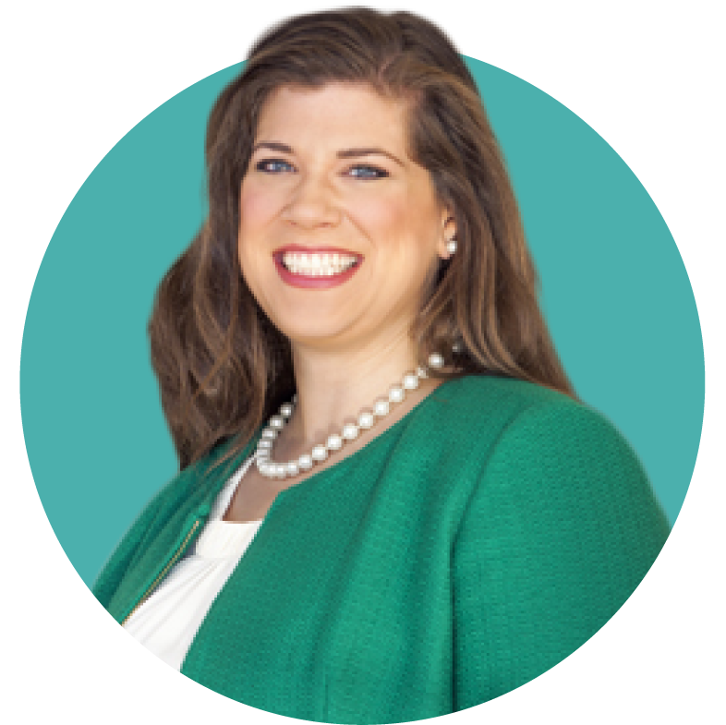




Today’s Presenters

Slide 4
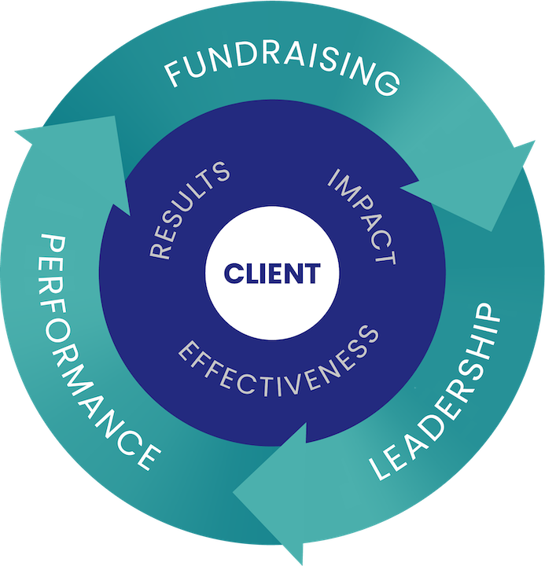
The Dini Spheris Advantage
54 years of results in fundraising, leadership and performance
Willingness to think outside the box of traditional fundraising
Proven track record of fundraising success with campaign goals of up to $1 billion
Belief in a values-based, donor-centered approach to philanthropy and fundraising
Customized and client-centered solutions for where you are today – and where you desire to go

Slide 5

Back to Basics
Identification
Receive
Gift!
Stewardship Activity
Stewardship Activity
Stewardship Activity
Solicitation
Discovery
Cultivation (3-10 times)
Solicitation
Notes:
Cultivation begins and ends with Stewardship and Engagement;; Continuous process

Slide 6
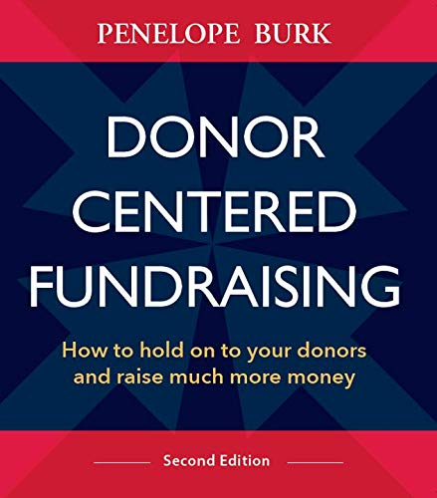
Wisdom from A Guru
“You invest a lot to acquire a donor, and the investment exceeds the return.
You only start making money with donor renewal.
If you wait and don’t bring donor relations in until some later date, then most donors are gone immediately because of a lack of donor relations.”
Notes:
Donors said that if their first gift was acknowledged promptly and in a meaningful way:
67% would definitely or probably renew
52% would make a larger gift
67% would continue to give indefinitely assuming they received these considerations each time they gave

Slide 7
Defining Stewardship & Recognition
Stewardship – being a good steward of the gift
  Transaction related – “the gift”
  Focused on accountability
  “Did we do what we said we would do?”
  Builds trust and confidence
  Recognition – the donor-facing work
    Maintain and advance relationships with donors
    Focused on engagement
Notes:
AIMEE START HERE
Both are important to creating a position donor experience; drive new and upgraded giving
Acknowledgement, recognition, engagement, stewardship – FOUR PILLARS!

Slide 8
What Donors Want in Stewardship

Slide 9
Grouping and Categorizing Helps Us Plan
Individual Donors
  Annual givers, Major givers
  Scholarship and program/department donors
  Faculty/Staff donors
  Legacy/Bequest donors
Corporate Donors
Foundation Donors
Notes:
15-20 min
Discussion – tell us about what you are currently doing

Slide 10
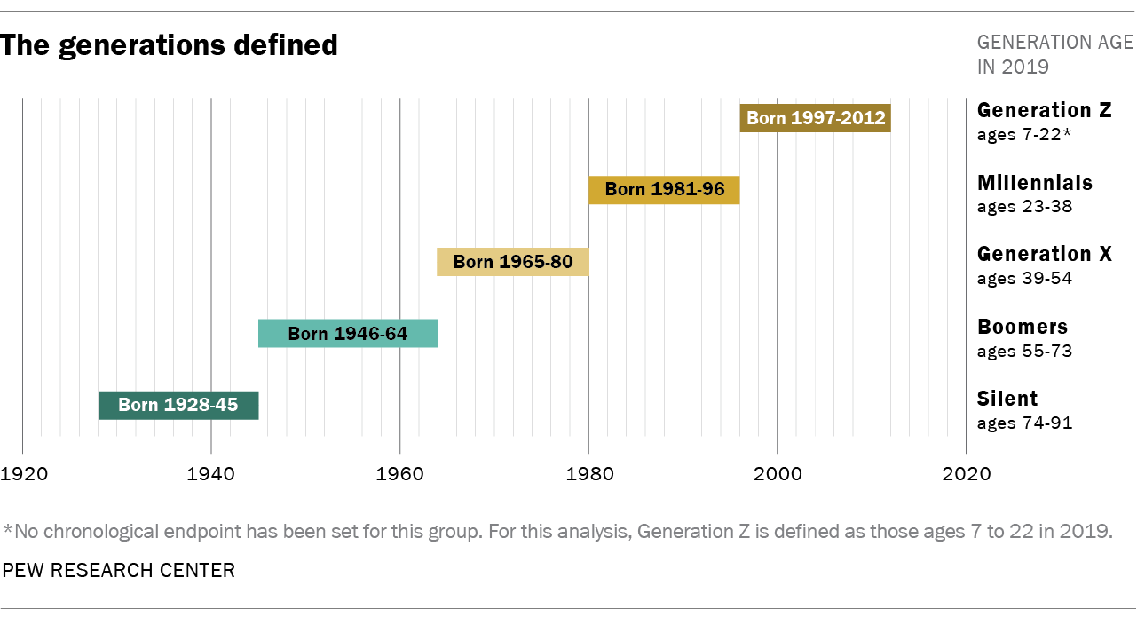
Individuals: Generations Overview
Notes:
Generational cutoff points aren’t an exact science
“Generation Shapers”
Technology: TV (Boomers); computers (GenX); Internet (Millennials); AI (GenZ)
Political Events/Milestones: Vietnam War (Boomers); Fall of Berlin Wall (GenX); 9/11 (Millennials); The Great Recession (GenZ)

Slide 11


The Generational Divide (Traditional)
Baby Boomers
Still represent the majority of all adults who give.
Contribute 43% of all dollars donated.
Decreasing their volunteer time dramatically.
More responsive to an emotional appeal, and via direct mail.
Concerned about the charity’s overall reputation.
Gen X
Focus giving on fewer organizations than Boomers.
Look for gift impact for confidence and continued giving.
More likely than other generations to give small to mid-level gifts over a longer period of time.
May be some of the greatest skeptics when it comes to confidence in nonprofits.
Sources: Fidelity Charitable: The Future of Philanthropy; Giving USA Special Report: Giving by Generations
Notes:
SW
Generational shifts are driving the transformation of philanthropy, demonstrated by the differences between two major forces in giving, Baby Boomers and Millennials.
• Millennials’ worldview is distinct from that of Baby Boomers. They approach philanthropy with a more global, social and inclusive outlook and express more optimism about philanthropy’s ability
to impact the issues most important to them.
• Millennials are much more likely to have incorporated new philanthropic trends into their giving. Sixty percent have been influenced by two or more trends, compared with 37 percent of Boomers.
• Millennials are more likely than Baby Boomers to believe almost all sectors have a role to play in solving society’s challenges, a view likely influenced by the interconnected world in which they’ve
grown up.
https://www.fidelitycharitable.org/docs/future-of-philanthropy.pdf

Slide 12


The Generational Divide (Next Gen)
Millennials
Recent studies show they have stepped up giving dramatically in the last 5-6 years.
Most likely to respond to direct mail AND email asks.
Likely to demand accountability and transparency (more than older donors).
Give less frequently and believe they can make the biggest difference by volunteering.
Gen Z
Giving in less traditional ways (e.g., to individuals and via social medial grassroots movements).
Plan for their charitable giving even more than other generations.
More likely than other generations to give to a charity on a monthly basis.
Considering their consumer habits as part of their overall scope of “giving.”
Sources: Fidelity Charitable: The Future of Philanthropy; Giving USA Special Report: Giving by Generations
Notes:
Millennials $942 in 2016; to $1,323 in 2022 (+40%) overall household giving

Slide 13
Individuals: Shared Trends
All generations are highly connected to technology.
All generations are giving online.
  Boomers: 61% report making at least one online gift in 2022
  Gen X: 69%
  Millennials: 81%
  Gen Z: 76%
All generations are still influenced (to some degree) to give by receiving direct mail.
  Boomers: 52%
  Gen X: 52%
  Millennials: 59%
  Gen Z: 45%
Sources: Giving USA Special Report: Giving by Generations
Notes:
87% of Boomers, and 96% of Gen X use a smartphone in 2022
Not only has the percentage of donors who give online increased across the generations, every generation has increased the average number of gifts given online in a 12-month period.
Speaking of direct mail, this current study shows that it is still a viable medium to generate a gift.
Prefer to respond to an ask via direct mail by giving online… least with Boomers.

Slide 14
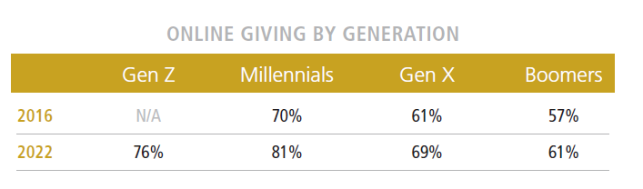
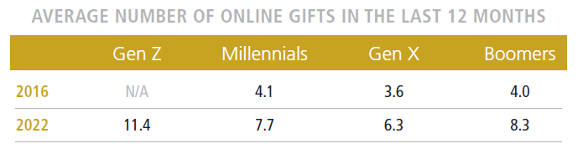
Individuals: Online Giving
Emotional response donating (or “rage giving”) is a thing – more likely amongst Millennials and Gen Z donors.
Retention of first-time online donors remains a challenge.
Notes:
BB
Online giving continues to grow as donors shift in age and other demographics.
May want to note the Rage Donations (not only for online giving) – this is an anecdotal from the Giving USA Webinar - growth in giving to organization working on Environment, Reproductive Health, Civil Rights, Immigration – these organizations need to have a plan to sustain these donors focusing on value and impact of their gift
https://www.afpnet.org/Audiences/ReportsResearchDetail.cfm?itemnumber=48368
Https://mrbenchmarks.com/#!/fundraising

Slide 15
Corporations: Trends to Watch
Corporations often utilize their charitable investments to improve the quality of the business environment in the locations where they operate.
Move Beyond the Usual Suspects
  Midsize Companies
  Think Locally
Corporate Partnerships are the key to Corporate Giving
  Cultivating corporate employees will help you move the needle
  Workforce development can take you a long way

Slide 16

Legacy Donors
Show them today the impact of
their future gift.
Connect them to students and impact the same way you would annual donors.
Give them opportunities to
tell their stories.
Remember that we may not know who has left us a planned gift!
Notes:
Loyal donors are some of our most likely planned gift donors (we may not even know they have left us planned gift) – Nancy’s story
Treat all donors regardless of gift size as valued partners; create opportunities for them to engage
Legacy societies – provide engagement in the same way you do your annual donors. Show them today what their impact will look like after they are gone. Connect them to students; faculty; college community.

Slide 17
Taking Stock
What are you currently doing to steward and recognize your donors?
  How are you saying thank you?
  Do you have an engagement and communication plan in place?
  How often are you reaching out?
  How are you reporting impact? How does it look different for different types of donors (e.g., current-use vs. endowed scholarship donors; emergency aid givers)?
  What recognition opportunities are you providing?
  Have you received feedback from donors on what they like and don’t like?
Notes:
15-20 min
Discussion – tell us about what you are currently doing

Slide 18
Where to Start
Gather insight from your donors
  Surveys
  Focus groups
  Volunteer engagement
Review your data
  Who are your donors?
  Individuals, corporations, foundation
  Faculty, staff, College retirees, community members, continuing education participants, alumni
  How do your donors give?
  Online, events, direct mail
  How do your donors interact with your social media?
Notes:
HOLLY TAKE OVER
Discussion – what types of questions would you ask? Have you done this kind of work?
Example – Rice created Annual Giving Leadership Council

Slide 19
Creating an Engagement Plan:
Tools in the Toolbox
Video messages (e.g., ThankView, GrataVid)
Events
Donor Stories
Social Media (especially Facebook, X, Instagram, LinkedIn)
Meetings with students, college leaders, or other givers (e.g., Virtual Town Hall, and 1:1 opportunities)
Volunteer opportunities (e.g., student mentorship)
Notes:
AIMEE & HOLLY TAG TEAM
Now that we know more about who are donors are and their preferences, its time to build out our engagement plan.
Create engagement opportunities based on what are donors have told us, how they currently interact with us – online, at events, etc.
May want to test some new engagement opportunities to gauge interest
Not every engagement opportunity needs to include a call to action. Goal can be simply to build relationship.
Don’t bite off more than you can chew. Provide quality experiences over quantity.
*Need to provide more detail on types of donors who these are best suited for and provide examples*

Slide 20
Contact Information
Holly Lang
Principal
Victor Brooks
Consultant
hlang@dinispheris.com
713.942.1213 (w)
832.715.7248 (c)
vbrooks@dinispheris.com
713.942.1228 (w)
361.813.5649 (c)
2727 Allen Parkway Suite 1650
Houston, Texas 77019

