Slide 1
Texas Association of Community College Foundations
Federal Grants
Love or Hate Them; They are your Friend

Slide 2
Grants are a Necessity for
Community Colleges
Grants support current programs
Grants help us to create new programs
Grants support scholarships
Grants support student success at our colleges
Grants come from Corporate Foundations, Foundations, the State, and Federal Sources
Grants are our friend or frenemy, depending on the funding source
Finding the right grants for our institution can take a lot of searching

Slide 3
Searching for Federal Grants Presents its own Challenges
Where to look? That is the question.
There are various free sources as well as paid search engines, such as:
Grants.gov
Individual agency or program newsletters.
Department of Education Grants website https://www2.ed.gov/fund/grants-apply.html?src=ft
Health Resources & Services Administration (HHS) website https://www.hrsa.gov/grants/index.html
National Endowment for the Humanities (NEH) https://www.neh.gov/grants
Grantscape – a Thompson Search Engine (subscription) https://www.thegrantscape.com/
The CASE Federal Funding Task Force (FFTF) Federal Funding Report for Education http://case-fftf.editme.com

Slide 4
CASE Federal Funding Task Force
The Federal Funding Task Force (FFTF) was created by the Council for Resource Development, which successfully managed the program until July 2016, when it became an initiative of the CASE Center for Community College Advancement.
FFTF is composed of volunteers from CASE member institutions of higher education, predominantly Community Colleges.
Each year, FFTF members meet with federal agency program officers to learn about: anticipated grant opportunities and funding levels; agency trends and program priorities; structural changes and agency contacts; and data about specific grant program and grants awarded in previous funding cycles.
FFTF members also advocate on behalf of institutions of higher education, explaining the valuable role we play in our communities and the positive impact that federal grants and programs have on students.
Usually there are about 60-65 members of the Task Force meeting with Federal program officers in Washington, DC and Maryland during the three-day meeting. For the past two years, however, these meetings have taken place virtually and the Task Force comprised about 35-40 members.
The culmination of these visits is the annual updating of the Federal Funding Report for Education available on the CASE website.
The FFTF Federal Agency Liaison Subcommittee is composed of members responsible for securing Federal Program Officers as session presenters at the Conference for Community College Grant Professionals. These individuals also participate on FFTF teams as well

Slide 5
CASE Federal Funding Task Force
Texas Community Colleges were well-represented on the 2021 Task Force, September 27 – October 21, 2021
Natalie Greenwell, Director, Grants Management, Collin County Community College District
Kathy McLendon, Director, Resource Development, McLennan Community College
Kim Moss-Linnear, Executive Director, Grants Development and Compliance, Tarrant County College District
Tomoko Olson, Director, Grants Management, San Jacinto Community College District
Lisa Smith, Grant Writer, Houston Community College
Victoria Waters, Grant Developer, Lone Star College

Slide 6
CASE Federal Funding Task Force
The group’s work begins long before we either arrive in Washington or participate in virtual meetings.
Volunteers read the previous year’s report on their assigned agencies; research assigned agencies’ website(s); participate fully in Team Meetings and Training Webinars.
After the meetings, teams participate in three debrief sessions presenting the results of all team meetings. Information about specific programs from the Program Officers is shared as well a tips learned in those conversations. This first-hand knowledge is invaluable.
An edited version of the team debrief sessions is then presented at the CASE Conference for Community College Grants Professionals Conference which follows FFTF.

Slide 7
CASE Federal Funding Task Force
2021 Highlights
Biden Administration has focus on outreach to and serving underserved communities.
New Department Secretaries means new priorities, these will be available early this year (2022)
Look at Executive Order 13985. Increased emphasis on proposals that address diversity, equity, and inclusion. This will be evident in new Department priorities.
Many programs want new reviewers. If interested, check the Departments’ websites for information about how to sign up. Each Department’s procedure is a little different.
Generally proposals must be clear. Do not assume a reviewer will be able to infer you meaning. As one program officer noted, “you do not want a reviewer asking questions about what you mean.” It could count against your proposal

Slide 8
CASE Federal Funding Task Force
2021 Highlights
Department of Education: Title III Strengthening Institutions Program (SIP)
Expect a new competition announcement in March/April 2022
Grants range from $400,000 - $450,000/year for 5 years
Average award is $425,000/year
Proposals follow a linear progression from Strengths and Weaknesses to Institutionalization. It all must tie together.
A logic model is required in the proposal.
The Evaluation Section should be very specific, use an expert evaluator, either in house or external.
Institutionalization of the project is critical. What will you keep from the strategies proposed? “Expecting increased revenue is not an institutional plan.”
Hopes to return to a 45 day window for proposal preparation; the ideal is 60 days. However if other elements get backed up this eats into the preparation window.
Unlike TRIO programs, Title III does not have an appeals process. Follow the directions and submit your best proposal.
Register to be a reviewer in G5. When your institution is not competing, it’s a great way to see the other side.

Slide 9
CASE Federal Funding Task Force
2021 Highlights
Department of Education: International and Foreign Language Education (IEFL)
New competition announcement for the Undergraduate International Studies and Foreign Language Program due in February 2022 with April 2022 due date. $2,936,969 available to fund approximately 32 grants. This Program is aimed at small institutions provides funds to plan, develop, and carry out programs to strengthen and improve undergraduate instruction in international studies and foreign languages.
New competition announcement for the Fulbright Hays-Group Projects Abroad Program due January/February 2022. $3,128,511 available to fund approximately 25 grants. Provides grants to support overseas projects in training, research, and curriculum development in modern foreign languages and area studies for K-12 teachers, college students, and faculty engaged in a common endeavor.
Recommend reviewing successful grants at https://iris.ed.gov/info/applications
Program staff is happy to discuss your proposal idea; contact early.
Be aware of the Travel Advisories issued by the U. S. Department of State. Recommendation is to not include Level 4 countries and have a back-up option if you include a Level 3 Travel Advisory country. Don’t consider China for example because it is a Level 4 country.

Slide 10
CASE Federal Funding Task Force
2021 Highlights
Department of Justice: Office on Violence Against Women (OVW)
In FY 2020, four grants awarded to Community Colleges.
The Grants to Reduce Sexual Assault, Domestic Violence, Dating Violence, and Stalking on Campus Program (Campus Program). Focuses on comprehensive prevention and intervention strategies that address and respond to domestic violence, dating violence, sexual assault, and stalking. Individual Institution awards: up to $300,000. Consortium awards: $550,000 - $750,000. Release date is usually in January with a March due date.
The Violence Against Women Act provides the impetus for the OVW’s Campus program. Be aware of this act and it’s components when applying.
OVW has resources for Community College, such as the toolkit for prevention found on their website. Guided by Community Colleges that have OVW grants. http://changingourcampus.org/

Slide 11
CASE Federal Funding Task Force
2021 Highlights
Department of Health and Human Services: Substance Abuse and Mental Health Administration (SAMHSA)
Emphasis remains on evidence-based practices. Most funding is now aimed at communities; not just mental health providers, instead the entire community as a whole.
What has changed is the way SAMHSA delivers services. There is an increase in telehealth – looking to develop new technologies and best practices.
Garrett Lee Smith Campus Suicide Prevention Program. Assists colleges and universities with suicide prevention and with enhancing identification and treatment of mental health disorders and substance abuse for all students. The infrastructure-building program supports development of a comprehensive, collaborative, well-coordinated and evidence-based approach to enhance services for all college students, including those at risk for suicide, depression, serious mental illness, and/or substance abuse disorders that can lead to school failure. Grants are up to $102,00/year for three years.
Community Colleges have been the lead on some grants; most often we are a collaborative partner.
SAMHSA has developed a webinar covering what makes a strong proposal. Check their website for that webinar and other helpful resources.

Slide 12
CASE Federal Funding Task Force
2021 Highlights
Environmental Protection Agency (EPA)
The Request for Applications (RFA) for the Environmental Justice Program is exclusively directed for Community Colleges. The focus is on underserved populations. Watch for a Spring 2022 announcement once all of the details are worked out.
EPA program staff want to engage more with community colleges.
People, Prosperity, and the Planet Program. Community Colleges have participated as subawardees; however, the Agency wants to see more Community Colleges and Minority Serving Institutions as lead applicants. This competition is open to teams of college/university students designing solutions for a sustainable future. Challenges students to research, develop, and design innovative projects. Phase 1 award: $25,000; Phase 2: $100,000.
Innovative Water Infrastructure Workforce Development Program. Supports projects relating to water workforce development and career opportunities in the drinking water and wastewater utility sector. Also projects expanding public awareness about drinking water and wastewater utilities. Awards range from $200,000 - $500,000. Potential announcement in spring 2022.
Program Officers are happy to follow up on unsuccessful proposals.
Be creative but realistic about your proposed projects. Identify issues and propose solutions that will build capacity.

Slide 13
CASE Federal Funding Task Force
2021 Highlights
Department of Education: Office of Elementary and Secondary Education (OESE)
College Assistance Migrant Program (CAMP). Assists students who are migratory or seasonal farmworkers (or their children) enrolled in their first year of undergraduate studies. Can be someone older, non-traditional student. Award: $180,000 - $475,000/year over five years. Competition announcements usually in the fall.
Full-Service Community Schools Program. Supports planning, implementation, and operation of full- service community schools that improve the coordination, integration, accessibility, and effectiveness of services for children and families, particularly for children attending high-poverty schools, including high-poverty rural schools. Community Colleges can be the lead applicant but must partner with a local ISD.
The Office is anticipating significant additional funding across their programs.

Slide 14
CASE Federal Funding Task Force
2021 Highlights
Department of Education: TRIO Student Support Services Programs
Pay close attention to Competitive Preference Priorities (CPPs).
There is a set of common instructions that include CPPs issued by the Office of Planning, Evaluation, and Policy Development. Look for a new set of instructions in February.
Applicants are encouraged to propose innovative and creative solutions to meet the needs of the population you want to serve.
Applications are reviewed by 3 non-federal peer reviewers so make sure to adhere to the selection criteria in the Notice of Application (NOA). Avoid jargon and make sure you connect the dots in your application.
Child Care Access Means Parents in School (CCAMPIS). Community Colleges received 35% of the awards in the last cycle. New competition expected in 2022. Department has requested a $40 million increase for this program. Stay tuned.
TRIO Student Support Services. Community Colleges received 50% of the awards during the 2020 competition. The next competition will be in 2025. There will be several TRIO training workshops in 2022; now is the time to start planning your proposal. Watch the TRIO Website for information.

Slide 15
CASE Federal Funding Task Force
2021 Highlights
Department of Education: Office of Career, Technical and Adult Education (OCTAE)
Under the Biden Administration, Community College support is a larger priority.
Programs will place greater emphasis on educating and training people for “pandemic-proof careers.
The pandemic has also creased the Department’s awareness of barriers to digital access/virtual learning.
Perkins continues to focus on high-quality CTE programs.
Program staff stressed importance of using OCTAE on-line resources, including its Stackable Credentials Toolkit, research centers, including the Community College Research Center, and the Community College Consortium for Open Educational Resources.
Keep watching OCTAE website and grants.gov for notice of open competitions.
The OCTAE Connections newsletter is a good way to keep up with their information. The link is on the website.

Slide 16
CASE Federal Funding Task Force
2021 Highlights
Department of Education: Hispanic Serving Institutions Division (HSI)
Whether the Department considers your Institution and HSI or not depends on your IPEDS report.
Priorities will include equity, access, support for the whole student (academic, social and emotional), encourage job-imbedded learning and apprenticeships, affordability, supportability and access, support towards completion, safe welcoming environment and diversifying the teacher workforce. Emerging challenges include childcare and non-academic support (food assistance, housing assistance, etc.). IHEs should serve as brokers of service and information through partnerships with local social service agencies. Department referred to this as “very intentional support”.
Hispanic Serving Institutions Division Program. Grants expand educational opportunities for and improve the academic attainment of Hispanic students, and expand and enhance the academic offerings, program quality, and institutional stability of the colleges and universities educating the majority of Hispanic students and help large numbers of Hispanic and other low-income students complete post-secondary degrees. Maximum award: $600,000/year for five years. FY 2022 notification is pending.
Hispanic-Serving Institutions – Science, Technology, Engineering, or Mathematics (HSI-Stem) and Articulation Programs. Grants (1) increase the number of Hispanic and other low-income students attaining degrees in the fields of science, technology, engineering, or mathematics; and (2) to develop model transfer and articulation agreements between two-year and four-year institutions in such fields. Awards: $700,000 - $1.2 million/year for five years. FY 2022 notification is pending.

Slide 17
CASE Federal Funding Task Force
2021 Highlights
Health Resources and Services Administration: Bureau of Health Workforce (HRSA:BHW)
Program Officers anticipate health equity, maternal health, and mental and behavioral health as future priorities.
This agency presents a wealth of information and a PowerPoint presentation during the FFTF annual visit. The materials are sent to the FFTF Team Captain after the meeting and are posted as attachments in the FFTF Report.
Area Health Education Centers Program (AHEC). Develops and enhances education and training networks within communities, academic institutions, and community-based organizations. Community Colleges can be partners. Currently at least 19 Community Colleges across the country who are sub-contractors. Spring 2022 anticipated competition.
Nurse Corps Scholarship Program. Provides scholarship to nursing students in exchange for a minimum two-year full-time service commitment (or part-time equivalent), at an eligible health care facility with a critical shortage of nurses. Open annually to individual applicants. Possible new competition, April 2022.
Opioid Workforce Expansion Program (OWEP) Paraprofessional Program. Funds eligible institutions to enhance community-based experiential training for students preparing to become peer support specialists and other types of behavioral health-related paraprofessionals with a focus on Opioid Use Disorder and other Substance Use Disorders prevention, treatment and recovery services. Anticipated competition, April 2022.
School-Based Loans: Nursing Student Loans Program. Eligible schools apply to participate in the loan program. Participating schools then offer loans to students in need who pursue a nursing degree. Each loan is long-term and low interest. Application requires schools to project the amount of funding needed for the one-year performance period

Slide 18
CASE Federal Funding Task Force
2021 Highlights
National Science Foundation: Division of Undergraduate Education (NSF:DUE)
New Agency Director has shown an increased interest in the role community colleges play and the role they play in applied research and emerging challenges. NSF is beginning to focus on the “missing millions” who did not enroll in community colleges during the pandemic.
Growing recognition and appreciation for community colleges and their impact on undergraduate STEM education. Grant Programs are starting to recognize that and some will indicate there is incentive money to partner with a community college on a project.
Program staff are willing to read a one-page concept paper anytime for feedback.
Many DUE programs have a capacity building track, and you may be able to use some funds to develop a group of faculty and administrators who then went to go on and pursue a larger opportunity.
Advanced Technological Education (ATE). Emphasis on two-year Institutions of Higher Education, the ATE program focuses on the education of technicians for the high-technology fields that drive our nation's economy. Columbus State University currently holds 16-17 active ATE awards. Grant Award Range: $350,000 over three years to $650,000 over three years. Next deadline: October 6, 2022.
Mentor-Connect Program. If interested in pursuing an ATE grant, consider joining the Mentor Connect Program. To help community colleges benefit from grant funding opportunities and continuous improvement through mentoring, faculty and leadership development, real-time technical assistance, and an online searchable database of NSF ATE-related resources.
https://www.mentor-connect.org/mentor-connect/program-overview

Slide 19
CASE Federal Funding Task Force
2021 Highlights
USDA: National Institute of Food and Agriculture (NIFA)
Education Programs Cover Many Topics – Don’t Just Think Plants and Animals or Agriculture. When it comes to USDA, growing, production, and business are important.
Upcoming RFA Calendar: https://nifa.usda.gov/upcoming-rfa-calendar. NIFA has several resources: weblinks included in provided presentation – Events Calendar, Newsletters, Blogs, Application Resources, Upcoming RFAs.
Be very clear about why your project is important to your region/area. Reviewers need to understand why you need the project to be funded. Make sure you justify each requested position.
Program Officers want to talk to you. Reach out to share ideas or ask questions. Workforce is an important topic and community colleges are the natural choice.
Secondary Education, Two-Year Postsecondary Education and Agriculture in the K-12 Classroom Challenge (SPECA). Enhance the quality of K-14 Instruction and increase the diversity and number of students. Award Amount: $50,000 - $300,000. Waiting FY 2022 competition announcement.
Agricultural Workforce Training (AWT). Develop new workforce training programs, improve or renew existing workforce training programs at community, junior, and technical colleges/institutes. Award Amount: $500,000. Next deadline date: September 14, 2022.

Slide 20
CASE Federal Funding Task Force
2021 Highlights
Department of Labor: Employment and Training Administration (DOL:ETA)
ETA is trying to reach rural areas and increasing the number of IHEs funded.
Watch the Apprenticeship.gov website. Seeking expansion of registered apprenticeship. Started publishing future opportunities with links to future opportunities.
Strengthening Community Colleges Training Grants. The purpose of this program is to (1) increase the capacity of Community Colleges to address employer, dislocated and unemployed workers, incumbent workers, and new workforce entrants skills development needs; (2) offer these workers accelerated career pathways that enable them to gain skills and transition from unemployment to (re)employment quickly; (3) address new challenges resulting from COVID-19 necessitating social distancing practices and expanding online and technology-enabled learning. Award Amount: $1,000,000 - $5,000,000. Anticipated competition: Winter 2022-2023.
Apprenticeship Building America Grant Program. Expands and modernizes Registered Apprenticeship through expanding the number of programs and apprentices, diversifying the industries that utilize Registered Apprenticeship, and increasing access to and completion of Registered Apprenticeship Programs. Award Amount: $1,000,000 - $8,000,000. Estimated opening date: February 7, 2022. Estimated due date: May 10, 2022.

Slide 21
CASE Federal Funding Task Force
Putting it all Together
After all the meetings, all the team debrief sessions, and the CCCGP Conference Sessions, it is time to edit the Federal Funding Report for Education. This is the premier resource on federal funding opportunities and is made available exclusively to members of the Council for Advancement and Support of Education (CASE).
The report encompasses grant information from 16 Federal Departments and Agencies and more than 200 individual program reports.
Teams complete there reports and send them to the FFTF Leadership Team for final edits and adding to the report. This is an ongoing process and the report remains open while the work is ongoing.

Slide 22
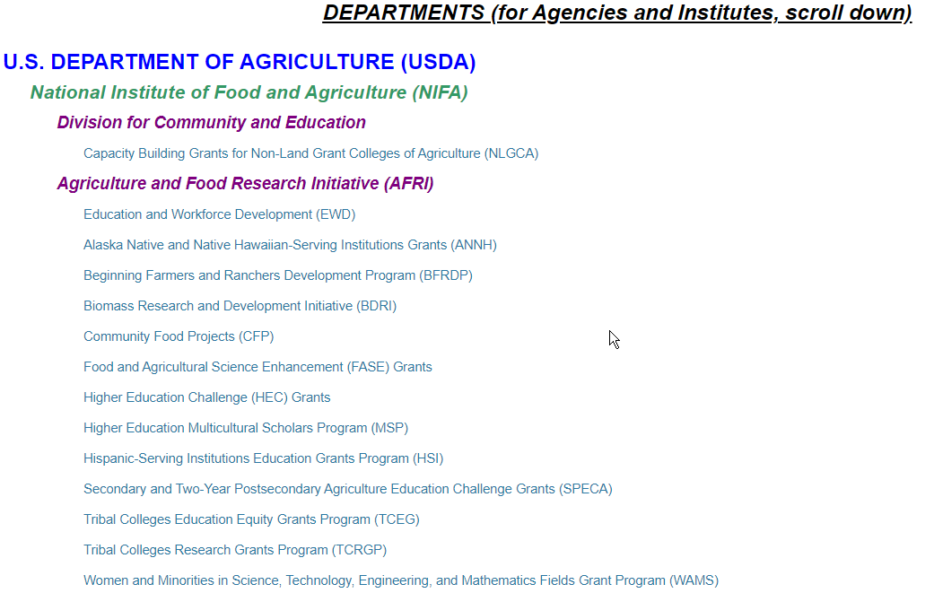
CASE Federal Funding Task Force
The Results

Slide 23
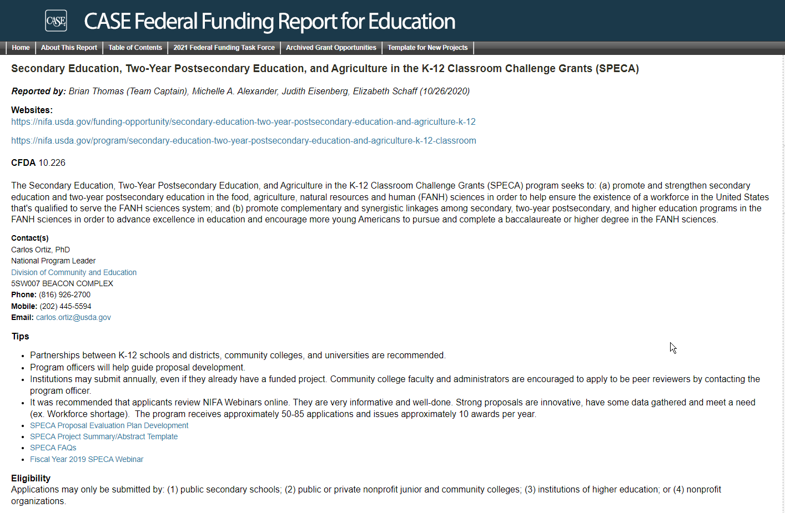
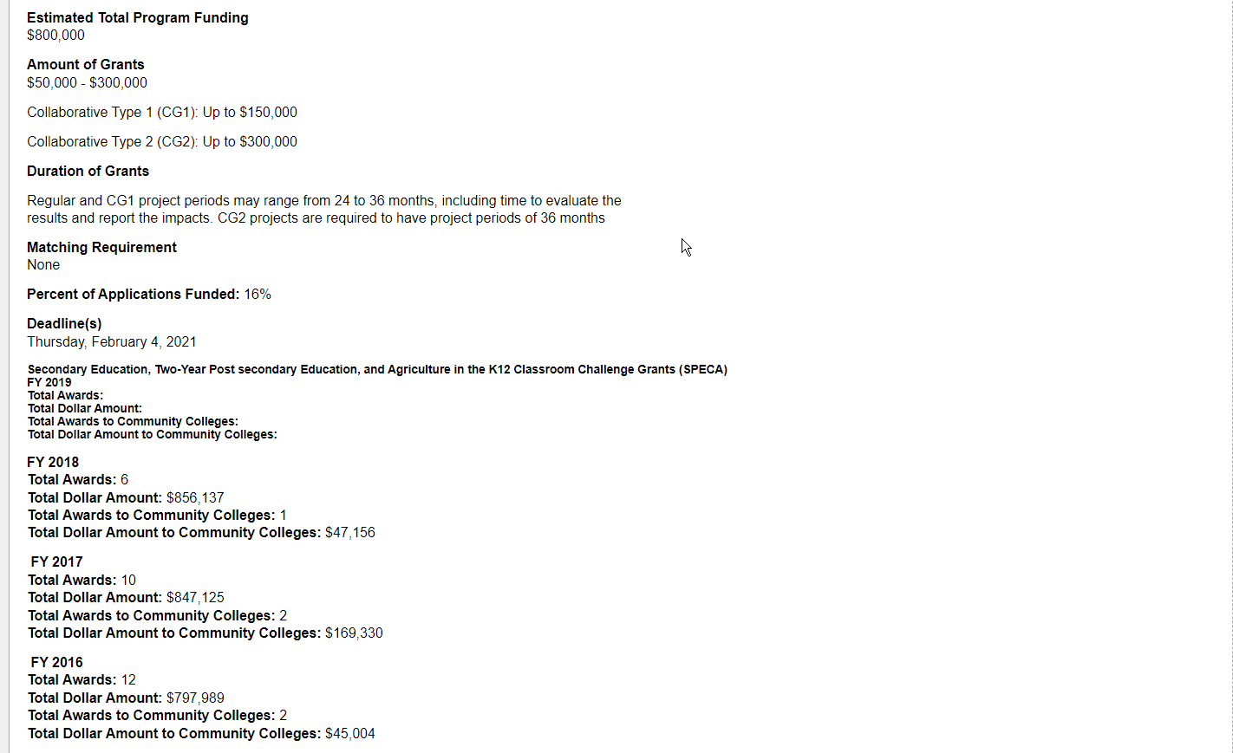
CASE Federal Funding Task Force
The Results

Slide 24
CASE Federal Funding Task Force
Come Join Us!
Currently we are anticipating FFTF returning to D.C. in fall 2022 for face to face meetings with Program Officers
Applications for 2022 will be available this spring. Watch for announcements from CASE.
You do not have to be a Grants Professional to join the Task Force. Participants come from various Institutional Advancement/Resource Development Departments and hold a wide range of positions.
The opportunity to network, get in front of program officers and learn first hand what is coming is invaluable.
The end of day debrief sessions provide a wealth of information that the Teams have gathered from the day’s visits.
And on top of that, we do have fun.

Slide 25
CASE Federal Funding Task Force
Questions???
Thank You
Michelle A. Alexander
Vice Chair, CASE 2021 Federal Funding Task Force
Director of Institutional Advancement, Vernon College/Executive Director, Vernon College Foundation
940-689-3846
malexander@vernoncollege.edu

