Slide 1


Your Fundraising Journey: Skills, Support, and Steps Forward
Guiding your path to successful fundraising outcomes
Presented by:
Denise Kaufman,
Del Mar College Foundation

Slide 2



Your Fundraising Journey
Objectives
1
Create a supportive space for learning and growth
2
Highlight how fundraising skills relate to other professional experiences
3
Offer a clear and useful roadmap for day-to-day success
4
Help organizations identify and nurture talent from diverse backgrounds

Slide 3



Your Fundraising Journey
Practice Your
Paddles
Raise the paddle that matches your answer
“Yes”
“No”
“I do not agree”
“I agree”
“That sounds like me”
“That’s never happened to me”

Slide 4

How long have you been in fundraising?

Slide 5
Have you ever walked into a room and forgot why you came in?

Slide 6
Have you ever trusted your instincts even when you weren’t 100% sure?

Slide 7

Your Fundraising Journey
Your Gut Isn’t Guessing…
It’s Experience in Disguise
Fundraising welcomes career changers, highlighting that diverse backgrounds enrich the field.
Skills from customer service, education, healthcare, and administration apply well in fundraising.
You’re here because someone recognized your talent and transferable skills.

Slide 8
Have you ever answered the phone in a 'nice voice' despite not feeling nice?

Slide 9


Your Fundraising Journey
Administrative Skills
Donor Information Management
  Managing donor data and tracking interactions is crucial for effective fundraising and stewardship.
Use of CRM Systems
  Fundraisers use CRM systems to schedule meetings, log activities, and monitor engagement efficiently.
Attention to Detail & Organization
  Accuracy, organization, and consistency are essential for documentation and process management.
Cross-Functional Relevance
  Administrative skills are vital across roles like project management, finance, and legal support.

Slide 10
Core
Competencies
Guiding your path to successful fundraising outcomes

Slide 11
Have you ever read the room so well that you felt like a human mood‑ring?

Slide 12

Your Fundraising Journey
Emotional Intelligence
Understanding Emotions
  Emotional intelligence involves recognizing and managing your own emotions effectively in different situations.
Empathy in Fundraising
  Fundraisers use empathy to recognize donor emotions and respond with sensitivity and understanding
Building Trust and Connections
  Emotional intelligence helps fundraisers build authentic relationships and trust with donors over time.

Slide 13
What is Frontline Fundraising?
Guiding your path to successful fundraising outcomes

Slide 14
Have you ever asked follow‑up questions because you genuinely wanted to know more?

Slide 15




Your Fundraising Journey
What is Frontline Fundraising?
Relationship Building
  Building and nurturing relationships is critical for sustaining long-term donor commitment and trust.
Listen with Purpose
Build Trust
Over Time
Partner in
Impact

Slide 16
Have you ever had that moment where you think, “I’m pretty sure that’s them… maybe?” before finally deciding to say hi?

Slide 17




Your Fundraising Journey
What is Frontline Fundraising?
Direct Donor Engagement
  Frontline fundraisers directly engage donors and prospects to build meaningful connections.
Meet Donors Where They Are
Build Understanding
Strengthen Commitment

Slide 18
Have you ever kept going after hearing “no” more than once?

Slide 19




Your Fundraising Journey
What is Frontline Fundraising?
Making the Donor Ask
  Frontline fundraisers directly ask donors and prospects to donate to their organization.
Invite Generous
Support
Present Giving
Opportunities
Align Passion with Need

Slide 20
Have you ever celebrated someone else’s win like it was your own?”

Slide 21




Your Fundraising Journey
What is Frontline Fundraising?
Fundraising Stewardship
  Fundraisers act as stewards to maintain donor connections and ensure ongoing support for the organization.
Show Gratitude
Immediately
Share the
Impact
Stay in
Touch

Slide 22
Understanding Frontline Fundraising
Guiding your path to successful fundraising outcomes

Slide 23

Your Fundraising Journey
Why It Matters
Securing Financial Resources
  Fundraisers are essential for obtaining the funding needed for organizational growth and operations.
Building Donor Relationships
  Strong relationships with donors foster trust and long-term commitment to the organization.
Aligning with Strategy
  Fundraisers contribute to strategic planning by ensuring personalized and thoughtful donor engagement.

Slide 24
Practical
Task
Lists
Guiding your path to successful fundraising outcomes

Slide 25

Your Fundraising Journey
Daily and Weekly
Tasks
Reviewing Donor Profiles
  Fundraisers regularly review donor profiles to understand donor history and preferences.
Logging Interactions
  Logging every interaction in CRM systems ensures accurate tracking of donor engagement.
Preparing and Following Up
  Preparation for meetings and timely follow-up communications strengthen donor relationships.
Team Strategy Sessions
  Participating in team sessions promotes accountability and aligns fundraising goals.

Slide 26

Your Fundraising Journey
Monthly and Quarterly Tasks
Analyze Donor Trends
  Regularly review donor engagement data to identify patterns and improve fundraising strategies.
Collaborate on Campaigns
  Work together with colleagues to plan and coordinate fundraising campaigns effectively.
Engage in Training
  Participate in professional development sessions to enhance skills and knowledge.
Report and Refresh Plans
  Update stewardship plans and report results to leadership to ensure alignment with goals.

Slide 27
Do you now realize you are more capable than you thought?

Slide 28
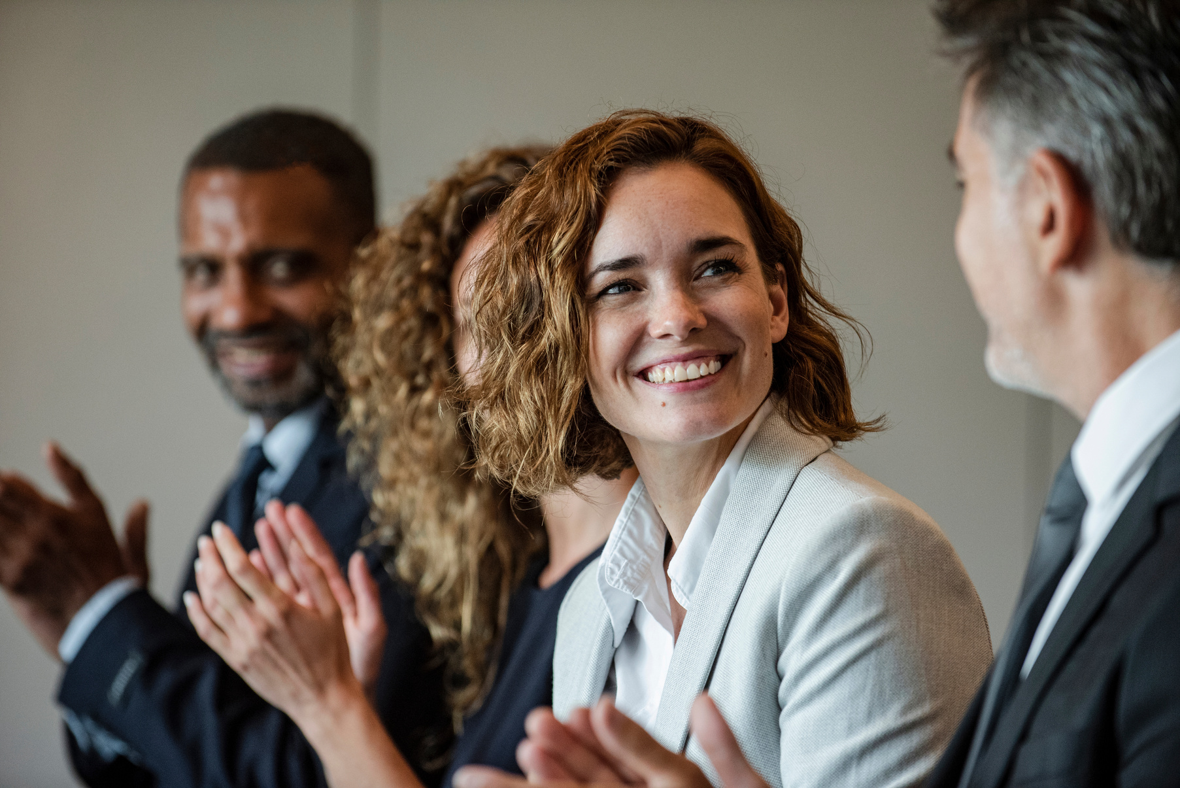

Your Fundraising Journey
Key Takeaways
Fundraising as a Journey
  Fundraising is a continuous journey supported by essential skills, a clear structure, and a strong community network.
Value of Contributions
  Every fundraiser's contributions are valuable and crucial to advancing the organization's mission.
Ongoing Support and Growth
  Support is available throughout professional development to inspire confidence and encourage continued learning.
Branches

Slide 29
So........
Do you know the secret to
Fundraising?

Slide 30
Q&A

Slide 31


Your Fundraising Journey
Thank
You
Let’s Connect
Denise Kaufman
Del Mar College Foundation
Senior Director of Donor Advising & Foundation Projects
+361-698-1321
dkaufman3@delamr.edu

