Slide 1
Talent Is the Strategy
Attracting, Hiring, and Retaining Exceptional Talent
in Community College Foundations
Presented by:
Janet Johnson
President and CEO
Jordan Johnson, Inc.
Notes:
Frame talent as a leadership and culture issue, not an HR problem.

Slide 2



The Real Competitive Advantage
People are the differentiator
Culture matters more than compensation
Notes:
Your foundation’s greatest competitive advantage is not your donors.
It’s not your strategy.
It’s not even your mission.
It’s your people.
And yet, across the nonprofit and foundation world, we are facing a quiet crisis.
We are asking extraordinary people to do:
More work
With fewer resources
Under increasing scrutiny
In emotionally demanding environments
And we’re surprised when they’re exhausted.
We talk about staffing shortages.
We talk about burnout.
We talk about the talent pipeline.
But rarely do we pause and ask the harder question:
What does it actually feel like to work here?
And why would a top performer choose us—and stay?

Slide 3

The Talent Market Has Shifted
Candidates choose cultures
Purpose must be sustainable
Notes:
Here’s the reality we need to name: The talent market has changed permanently.
High-performing professionals today are not just asking:
What will I be paid?
What will my title be?
They are asking:
Will my work matter?
Will I be supported?
Will I be developed?
Will I burn out here?
Will I be proud of how leadership shows up?
Top talent no longer chooses organizations.
They choose cultures.
And in the nonprofit world—especially donor-based foundations—this shift is even sharper.
Because the work is meaningful.
And meaningful work without boundaries becomes unsustainable.

Slide 4

Why Foundations Are Losing Great People
Mission without boundaries
Chronic urgency
Emotional labor
Notes:
Why Foundations Are Losing Great People (5 minutes)
Let’s be honest. People don’t leave foundations because they don’t care about the mission.
They leave because:
The mission is used as a substitute for support
Scarcity becomes normalized
Urgency never turns off
Leadership absorbs pressure—but doesn’t always absorb pain

Slide 5

Burnout Is a Leadership Issue
Not weakness
A system problem
Notes:
BURNOUT is a Leadership Issue
Burnout doesn’t come from working hard. Burnout comes from working hard without control, clarity, or recovery.
And in donor-driven environments:
Every ask feels urgent
Every relationship feels personal
Every setback feels like failure
When leaders don’t intentionally design how work gets done, the most committed people pay the price.

Slide 6

What Attracts Top Talent Today
Meaning with boundaries
Notes:
What Attracts Top Talent to Foundations Today (6 minutes)
If you want to attract exceptional people in today’s environment, salary alone is not enough—especially in nonprofits.
What does attract them?
3. Growth, Not Just Gratitude
Top talent wants to grow.
Not just be thanked.
Not just be loyal.
But to:
Learn new skills
Be challenged
See a future beyond their current role
Foundations that invest in development—even modestly—signal something powerful:
“We see you as more than capacity.”

Slide 7
What Attracts Top Talent Today
Meaning with boundaries
Leadership they can trust
Notes:
What Attracts Top Talent to Foundations Today (6 minutes)
If you want to attract exceptional people in today’s environment, salary alone is not enough—especially in nonprofits.
What does attract them?
3. Growth, Not Just Gratitude
Top talent wants to grow.
Not just be thanked.
Not just be loyal.
But to:
Learn new skills
Be challenged
See a future beyond their current role
Foundations that invest in development—even modestly—signal something powerful:
“We see you as more than capacity.”

Slide 8
What Attracts Top Talent Today
Meaning with boundaries
Leadership they can trust
Growth, Not just gratitude
Notes:
What Attracts Top Talent to Foundations Today (6 minutes)
If you want to attract exceptional people in today’s environment, salary alone is not enough—especially in nonprofits.
What does attract them?
3. Growth, Not Just Gratitude
Top talent wants to grow.
Not just be thanked.
Not just be loyal.
But to:
Learn new skills
Be challenged
See a future beyond their current role
Foundations that invest in development—even modestly—signal something powerful:
“We see you as more than capacity.”

Slide 9
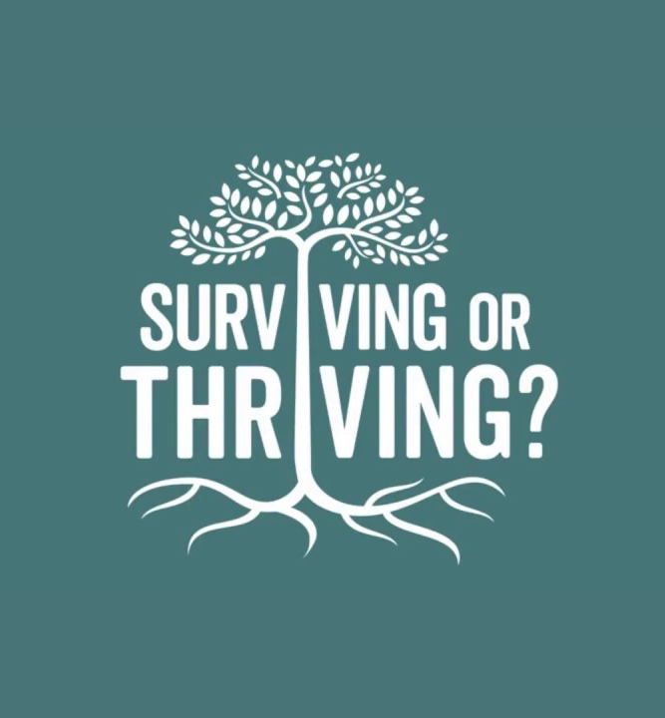
Hiring for the Long Term – NOT the Emergency
Transparency
Sustainability
Notes:
Hiring for the Long Term, Not the Emergency (5 minutes)
One of the biggest traps in nonprofit hiring is urgency. We hire because:
We’re behind
Someone left
We’re overwhelmed
But when we hire in panic, we often:
Over hire resilience
Under hire clarity
Reward people who say “yes” to everything
Instead, long-term hiring requires a shift: From “Can you survive here?”
To “Can you thrive here?”
That means being honest in the hiring process about:
The pace
The pressure
The expectations
The support structures
Transparency doesn’t scare off top talent.
It attracts the right talent.

Slide 10

Retention Is a Leadership Practice, not an HR Program
Clarity
Consistency
Safety
Notes:
Retention Is a Leadership Practice, Not an HR Program (4 minutes)
Here’s the uncomfortable truth:
People don’t stay because of policies.
They stay because of daily leadership behavior.
They stay when:
Expectations are clear
Feedback is timely and respectful
Priorities don’t change weekly
Leaders notice strain before burnout
Retention isn’t about perks. It’s about psychological safety and predictability. Especially in foundation work, where emotional labor is high, leaders must ask: “How am I designing the experience of working here?”

Slide 11

High Standards Without Burnout
Focus
Discipline
Notes:
Addressing Burnout Without Lowering Standards (4 minutes)
Here’s an important distinction:
Addressing burnout does not mean lowering expectations. It means:
Being disciplined about priorities
Saying no more often
Stopping the myth that urgency equals importance
High-performing people don’t burn out because standards are high. They burn out because everything is treated as critical. Leadership’s job is not to absorb pressure silently. It’s to translate pressure into focus.

Slide 12
What Exceptional Foundations Do Differently
Foundations that retain great people over time share a few traits:
    Leaders talk openly about capacity
    Mission is paired with structure
    Success is shared, not hoarded
    Development is intentional, even if informal
    Leaders model sustainability—not martyrdom
    They send one clear message: “We care about the work—and the people doing it.”
Notes:
What Exceptional Foundations Do Differently (4 minutes)
Foundations that retain great people over time share a few traits:
Leaders talk openly about capacity
Mission is paired with structure
Success is shared, not hoarded
Development is intentional, even if informal
Leaders model sustainability—not martyrdom
They send one clear message: “We care about the work—and the people doing it.”

Slide 13

Leadership Discussion Questions
What does it feel like to work here?
What are we modeling?
When candidates interview with us what signals do they receive?
Where is our culture misaligned?
Do we reward burnout?
What, if anything, should we stop doing?
Notes:
Pause for reflection.

Slide 14
Talent Is the Strategy
Culture is the employer brand
Leadership behavior determines who stays
Notes:
Close with leadership challenge.

Slide 15
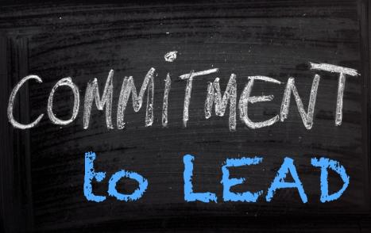
Discussion: Leadership Commitments
What will I do differently?
What behavior will I model?
Notes:
Invite commitments.

